Slide 1


Computational Accounts of Trust in Human-AI Interaction
Yochan Lab
Ph.D. Defense
Zahra Zahedi
Dr. Subbarao Kambhampati, Dr. Erin Chiou, Dr. Yu Zhang, Dr. Siddharth Srivastava
Chair

Slide 2

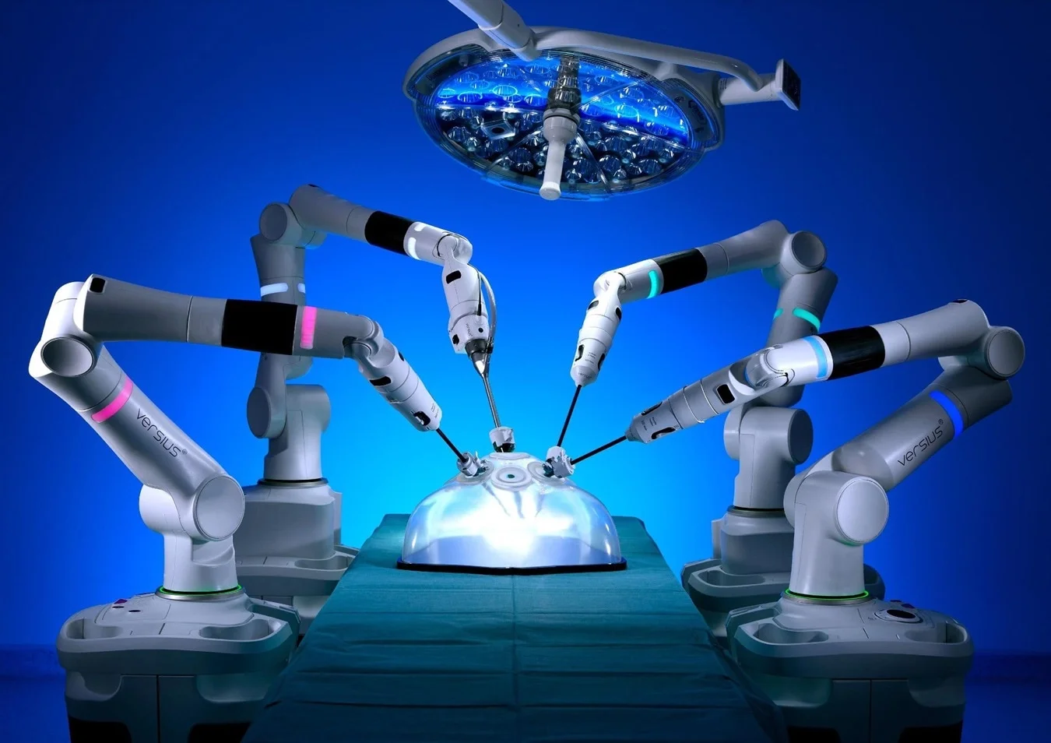

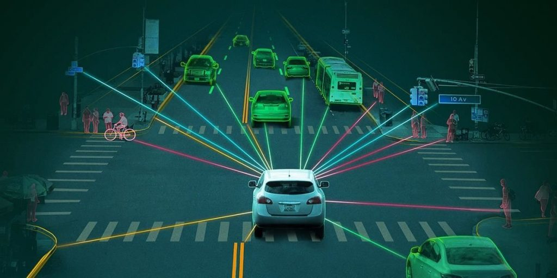
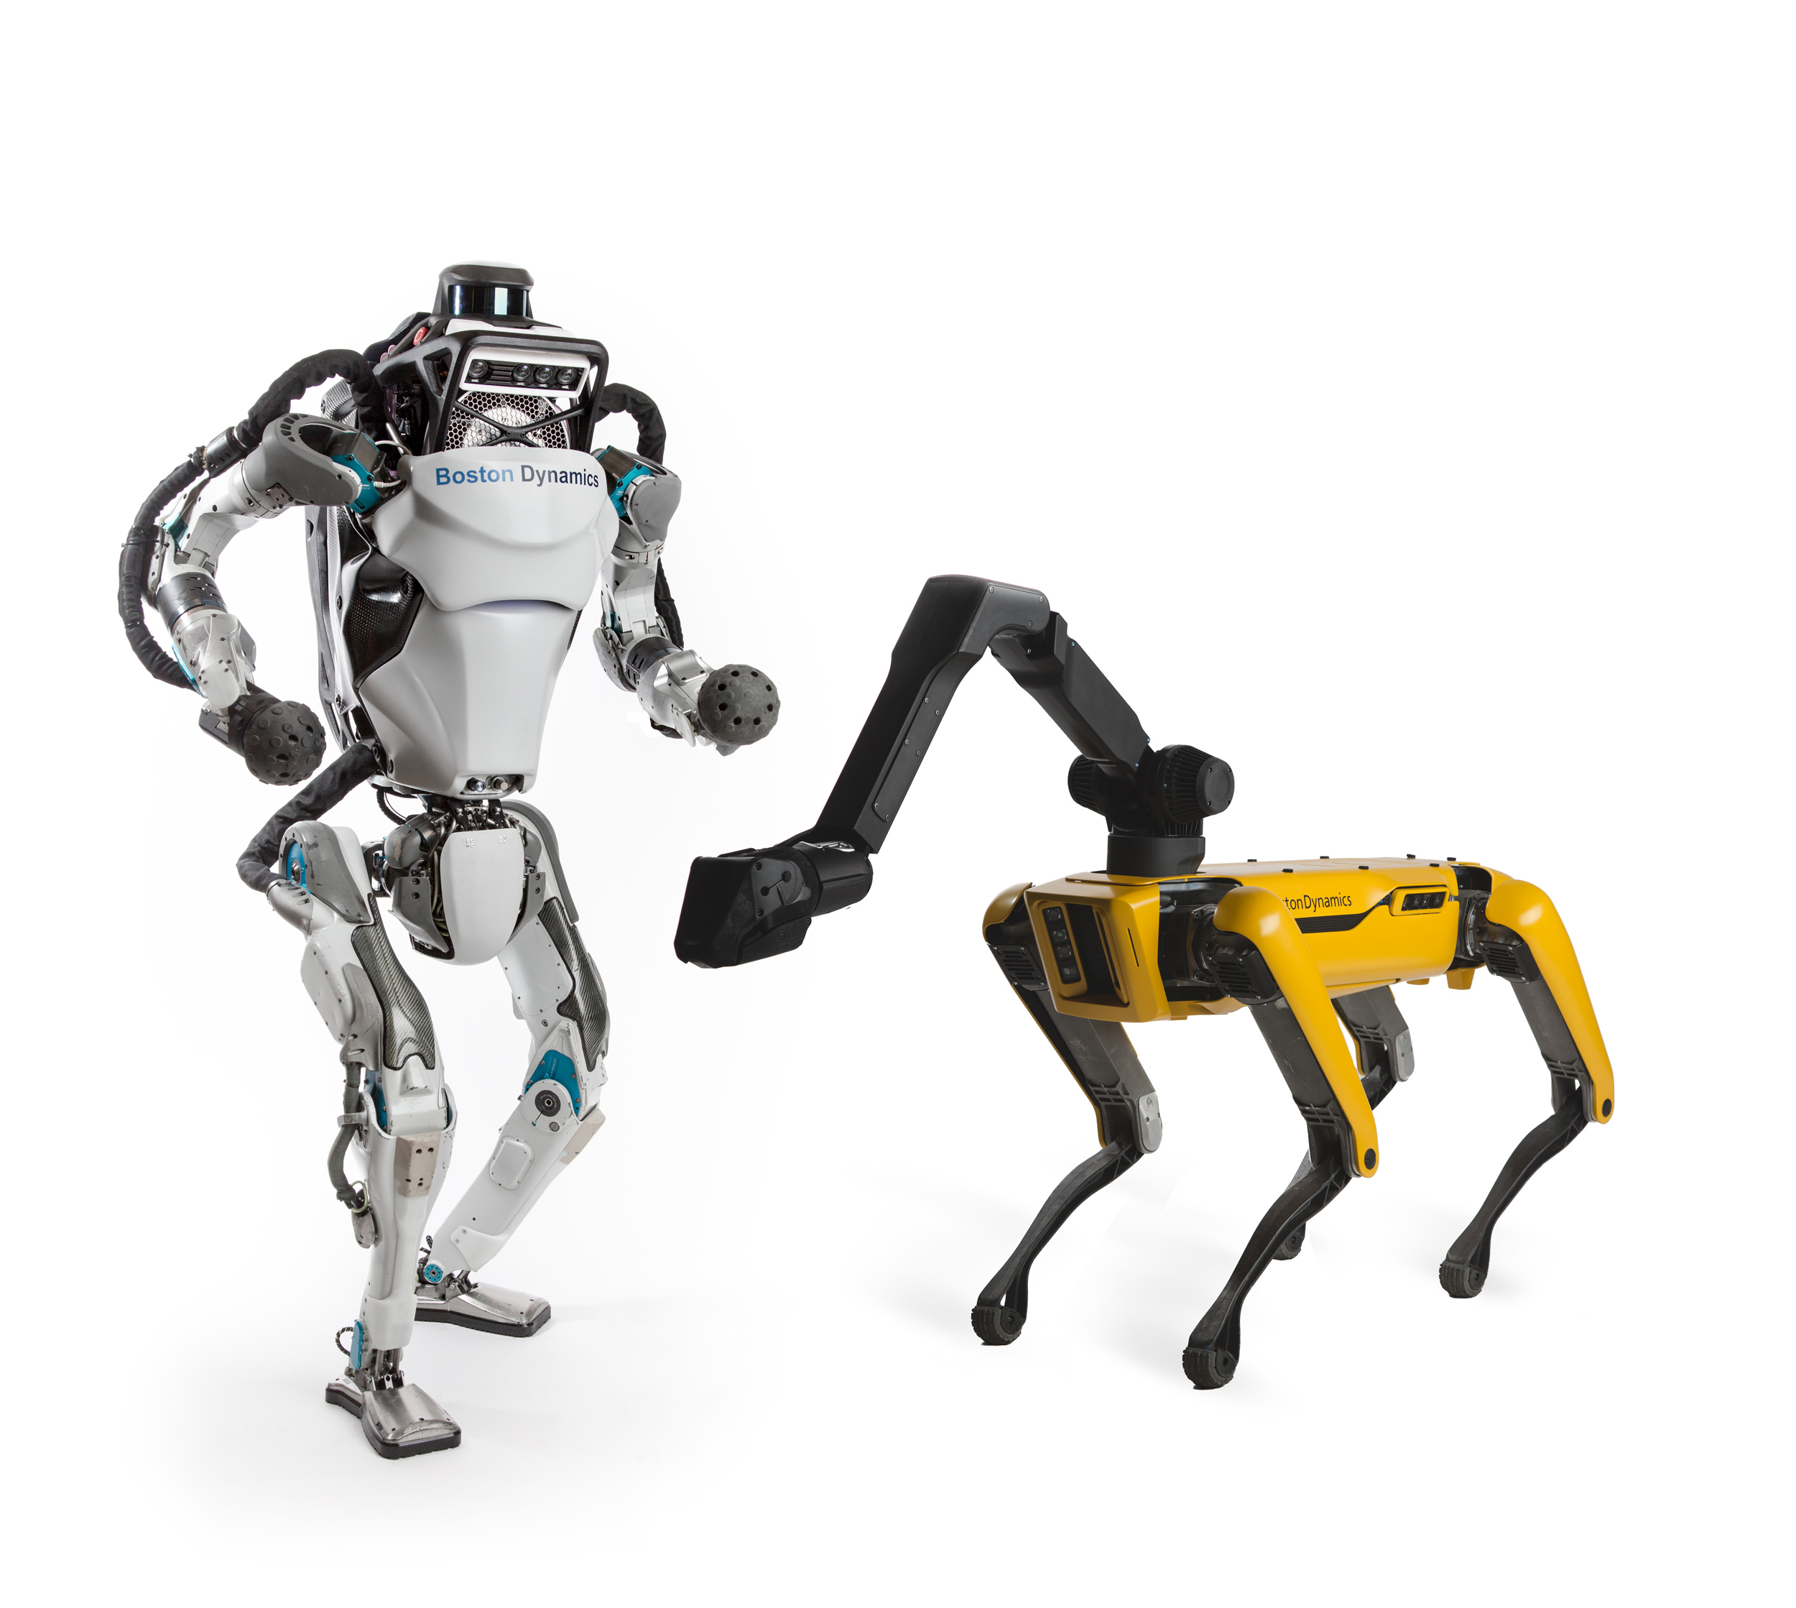
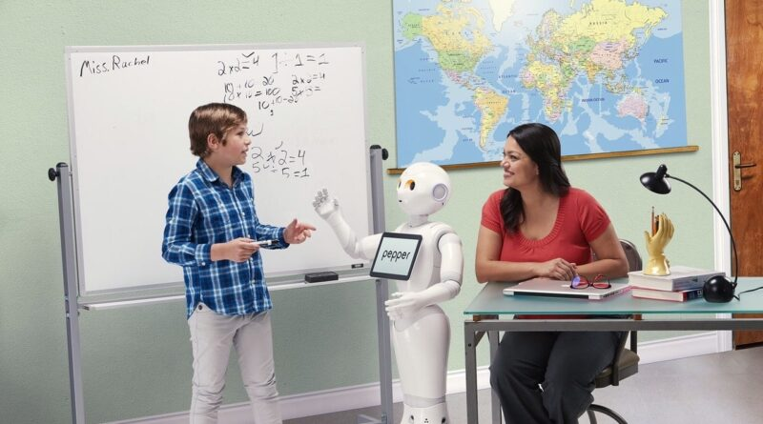
Introduction
istockphoto.com
Healthcare
Image Credit: CMR Surgical
Social
Media
AI
We are beginning to observe the significant impact that AI can have on a range of practical tasks.
Finance
Transport
zesium.com/
https://robotenomics.com/
Robotics
Education
https://biomech.stanford.edu/robotics/
https://www.techedmagazine.com/

Slide 3

Introduction
istockphoto.com
Healthcare
Image Credit: CMR Surgical
Social
Media
Establishing trust between humans and AI systems is paramount
AI
To fully leverage the benefits of AI and foster its integration into our lives
Finance
Transport
Without trust, the true potential of AI may remain untapped
zesium.com/
https://robotenomics.com/
Robotics
Thelgroup.com
Education
Hindering its acceptance, adoption, and overall effectiveness
https://biomech.stanford.edu/robotics/
https://www.techedmagazine.com/

Slide 4

Introduction
“An appropriate level of trust”
Over trust or misplaced trust can be catastrophic
Establishing trust requires understanding of each other’s roles and capabilities
https://www.vecteezy.com/
Trust-aware frameworks are critical
Especially a generalized and consistent formalization
Notes:
AI systems have to engender trust in human in the loop, the complex task of engendering an appropriate level need a balance

Slide 5
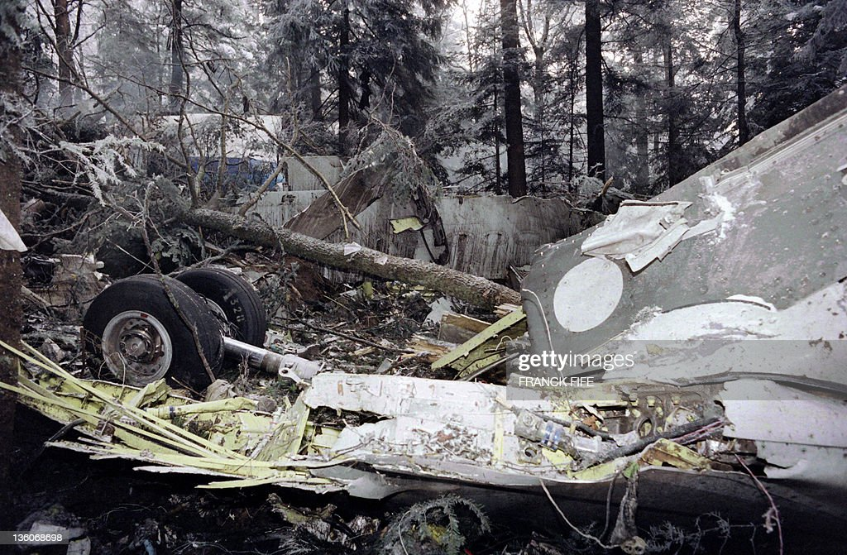
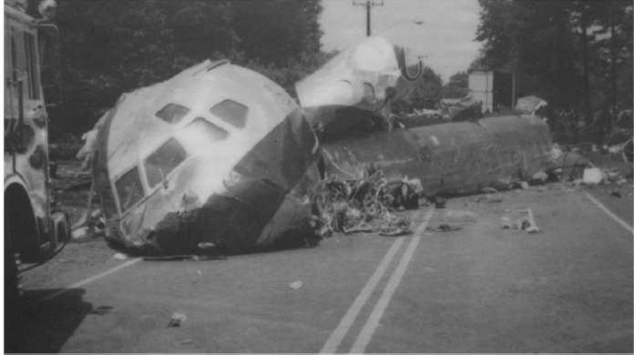
Introduction
“An appropriate level of trust”
Over trust or misplaced trust can be catastrophic
Remnants of the aircraft N954VJ involved in USAir Flight 1016
Establishing trust needs understanding of each other’s roles and capabilities
Air Inter A320 accident near Strasbourg France on January 20, 1992
https://www.vecteezy.com/
Trust-aware frameworks are critical
Especially a generalized and consistent formalization
Notes:
AI systems have to engender trust in human in the loop, the complex task of engendering an appropriate level
This highlights a critical requirement for building lasting trust

Slide 6
Introduction
“An appropriate level of trust”
Over trust or misplaced trust can be catastrophic
Establishing trust Requires understanding of each other’s roles and capabilities
https://www.vecteezy.com/
Trust-aware frameworks are critical
Especially a generalized and consistent formalization
Notes:
dynamics within human-AI teams need a special attention
AI agents to understand human models and expectations about its capabilities and, if necessary, correct human them
This highlights a critical requirement for building lasting trust
for understanding, estimating, and fostering an appropriate level of trust

Slide 7
Background: Different Directions of Trust Studies
Psychological and Human factors view
Computational accounts of trust

Slide 8
Background: Different Directions of Trust Studies
Psychological and Human factors view
Computational accounts of trust
Definitions
Information and characteristics
Quantifying
Inference
Utilization
Calibration
Rotter (1967); Rempel et al. (1985); Barber (1983); Johns (1996); Moorman et al. (1993); Mayer et al. (1995); Deutsch (1960); Meyer (2001)
Lee and See (2004) ); Barber (1983); Jacovi et al. (2021)
Muir (1994); Cummings et al. (2008); Ullman and Malle (2018); Merritt et al. (2013)
Desai (2012); Kok and Soh (2020); Xu and Dudek (2015); Guo et al. (2020); Soh et al.
(2020); Desai et al. (2013, 2012)
Floyd et al. (2015); Xu and Dudek (2012, 2016); Wang et al. (2015); Chen et al. (2018, 2020); Nikolaidis et al. (2017);
Liu et al. (2019)
Billings et al. (2012); Baker et al. (2018); Tolmeijer et al. (2020); De Visser et al. (2018); Robinette et al. (2015); Sebo et al. (2019); Wang et al. (2016)
Definition of Trust
The attitude that an agent will help achieve an individual’s goals in a situation characterized by uncertainty and vulnerability
Lee and See (2004)

Slide 9
Background: Different Directions of Trust Studies
Psychological and Human factors view
Computational accounts of trust
Definitions
Information and characteristics
Quantifying
Inference
Utilization
Calibration
Three informations of trust
Rotter (1967); Rempel et al. (1985); Barber (1983); Johns (1996); Moorman et al. (1993); Mayer et al. (1995); Deutsch (1960); Meyer (2001)
Lee and See (2004) ); Barber (1983); Jacovi et al. (2021)
Muir (1994); Cummings et al. (2008); Ullman and Malle (2018); Merritt et al. (2013)
Desai (2012); Kok and Soh (2020); Xu and Dudek (2015); Guo et al. (2020); Soh et al.
(2020); Desai et al. (2013, 2012)
Floyd et al. (2015); Xu and Dudek (2012, 2016); Wang et al. (2015); Chen et al. (2018, 2020); Nikolaidis et al. (2017);
Liu et al. (2019)
Billings et al. (2012); Baker et al. (2018); Tolmeijer et al. (2020); De Visser et al. (2018); Robinette et al. (2015); Sebo et al. (2019); Wang et al. (2016)
Purpose
Process
Performance
Why AI is developed. Whether the agent has a positive orientation
How AI operates. Quality of actions based on human expectations
What AI does. Competency or proficiency in achieving the goal
Definition of Trust
The attitude that an agent will help achieve an individual’s goals in a situation characterized by uncertainty and vulnerability
Lee and See (2004)

Slide 10
Background: Different Directions of Trust Studies
Psychological and Human factors view
Computational accounts of trust
Definitions
Information and characteristics
Quantifying
Inference
Utilization
Calibration
Rotter (1967); Rempel et al. (1985); Barber (1983); Johns (1996); Moorman et al. (1993); Mayer et al. (1995); Deutsch (1960); Meyer (2001)
Lee and See (2004) ); Barber (1983); Jacovi et al. (2021)
Muir (1994); Cummings et al. (2008); Ullman and Malle (2018); Merritt et al. (2013)
Desai (2012); Kok and Soh (2020); Xu and Dudek (2015); Guo et al. (2020); Soh et al.
(2020); Desai et al. (2013, 2012)
Floyd et al. (2015); Xu and Dudek (2012, 2016); Wang et al. (2015); Chen et al. (2018, 2020); Nikolaidis et al. (2017);
Liu et al. (2019)
Billings et al. (2012); Baker et al. (2018); Tolmeijer et al. (2020); De Visser et al. (2018); Robinette et al. (2015); Sebo et al. (2019); Wang et al. (2016)
Definition of Trust
The attitude that an agent will help achieve an individual’s goals in a situation characterized by uncertainty and vulnerability
Lee and See (2004)

Slide 11
Background: The Gap in The Literature
Human factors views of trust
Computational models of trust
Vulnerability
Trust from a more technical perspective
Utilizing algorithms and data-driven methods
Quantifying trust based on observed behaviors and performance metrics
Trust as reliability of a system (Performance)
Insights into how individuals perceive, develop, and maintain trust
Qualitative exploration
Helps in shaping AI systems that align more closely with human expectations
Anticipation
Performance
Process
?
Purpose
Notes:
Vulnerability aspect of trust is inherent in these studies in different capacities, considering that trust in robots implies potential risks to the users,
Anticipation drives the development and adaptation of these models
focus on the performance dimension of trust, reflecting the reliability of robotsin achieving a goal, the process and purpose dimensions have largely been overlooked

Slide 12
My Research Direction
Generalized and consistent mental model based formalizations of trust
Foundation for understanding, estimating, and fostering an appropriate level of trust
Captures the multi-dimensional aspects of trust and bridge the gap
Developing decision-making frameworks that leverage our mental model based framework to guide both single and longitudinal interaction
Utilizing our framework for trust inference
Notes:
practical application of our mental model-based framework

Slide 13
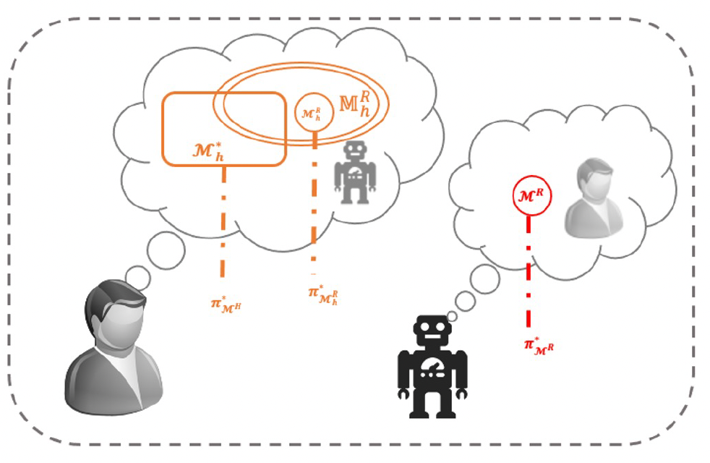

Research Contributions
Computational models
Human factor views
Decision making frameworks
Perceptions and characteristics
Structure
Inference
Human
Designer
Robot
Trust change
diff perceptions
AAMAS’ 19; Trust R:SS’ 21; R4P
Under-rev. THMS
HRI’ 22; lbr
HRI’ 23
ICAPS’ 20, XAIP
IJCAI’23, XAI
Single
Interaction
Longitudinal
Notes:
overviiew

Slide 14
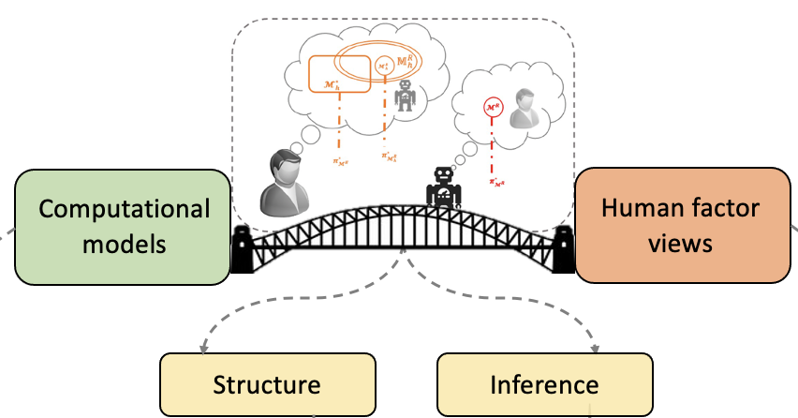
Agenda
Mental Model Based Framework of Trust
Interaction Settings
Trust in Mental Model States
Three trust information within framework
Developing Decision Making Frameworks Monitoring and Trust
How a designer can use the framework (Single interaction)
How a robot can use the framework (Iterated Interaction) Evaluating Trust Inference
Inferring trust dynamic
Controlling perceptions of trust
Other Research Contributions

Slide 15
Agenda
Mental Model Based Framework of Trust
Interaction Settings
Trust in Mental Model States
Three trust information within framework
Developing Decision Making Frameworks Monitoring and Trust
How a designer can use the framework (Single interaction)
How a robot can use the framework (Iterated Interaction) Evaluating Trust Inference
Inferring trust dynamic
Controlling perceptions of trust
Other Research Contributions

Slide 16
Mental Model Based Framework of Trust
Computational models
Human factor views
Decision making frameworks
Perceptions and characteristics
Structure
Inference
Human
Designer
Robot
Trust change
diff perceptions
Single
Interaction
Longitudinal

Slide 17
Mental States of Human and Robot
Mental model state of interaction

Slide 18
Mental States of Human and Robot
Robot Performer
Human Supervisor
Mental model state of interaction
Notes:
robot is performing the task
human is undertaking a supervisory role

Slide 19
Mental States of Human and Robot
Robot Performer
Human Supervisor
Model of the agent
Mental model state of interaction

Slide 20
Mental States of Human and Robot
Set of the human’s models of the agent
Robot Performer
Human Supervisor
Model of the agent
Mental model state of interaction
Notes:
Empty or multiple with different probability based on the information or experience the human has

Slide 21
Mental States of Human and Robot
Set of the human’s models of the agent
Robot Performer
Human Supervisor
Human’s task model
Model of the agent
Mental model state of interaction
Z. Zahedi, S Sreedharan, S Kambhampati,“A Mental Model Based Theory of Trust”, XAI workshop at IJCAI 2023
Notes:
Captures the desirable way the human want the task to be done

Slide 22
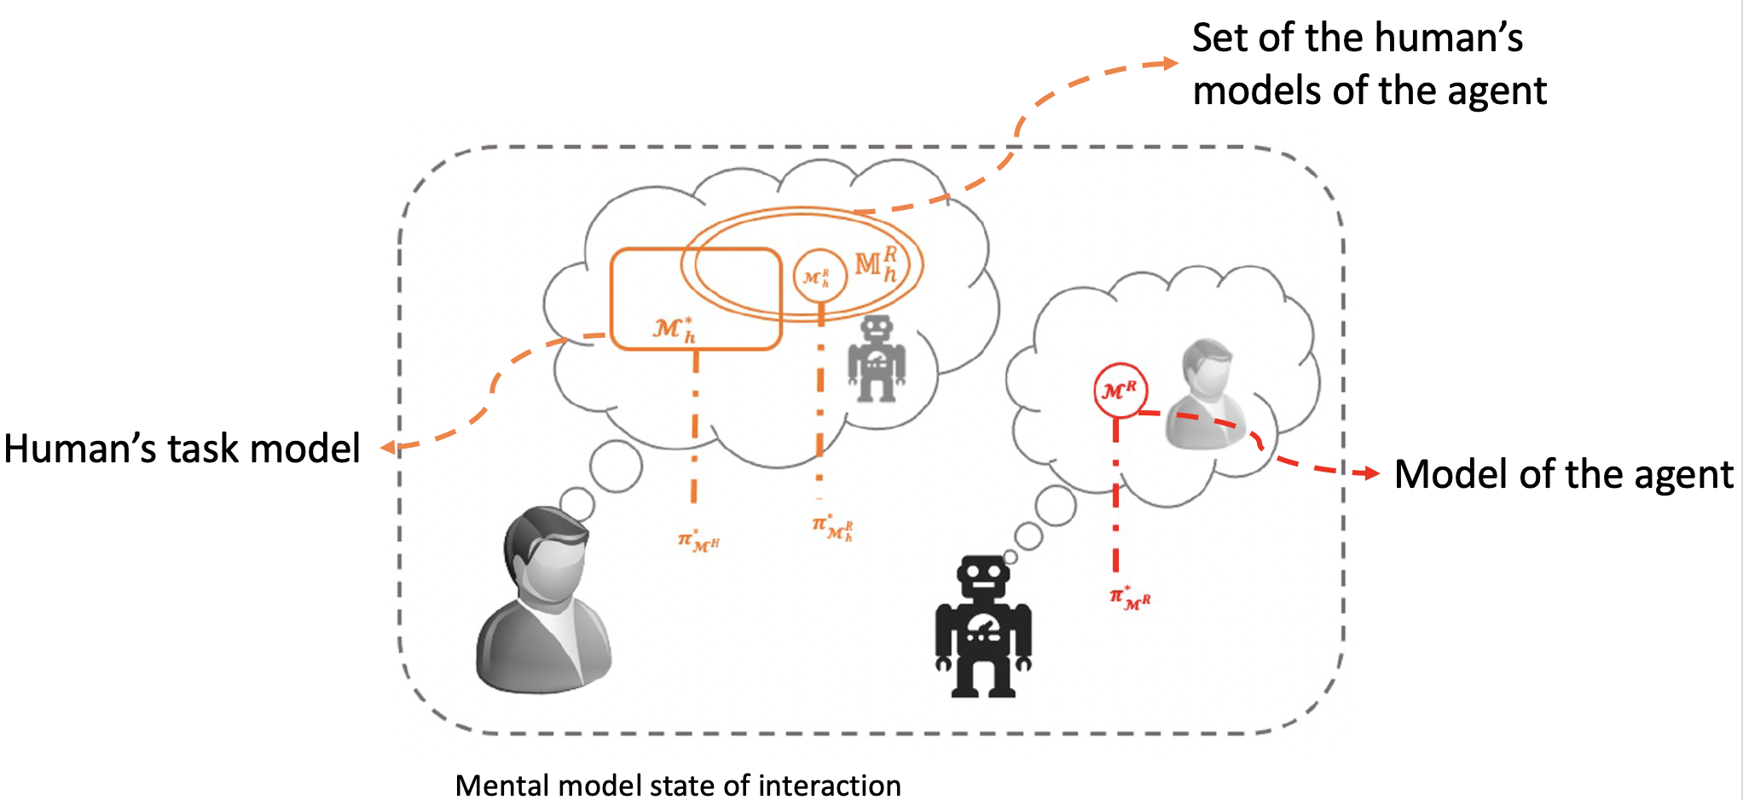
Mental States of Human and Robot
Robot Performer
Human Supervisor
Model
An agent’s beliefs about task objectives
State of the world
How the world may evolve on its own or in response to an agent action
Notes:
any formal model that encodes, among other things, an agent’s beliefs about task objectives, state of the world and how the world may evolve on its own or in response to an agent action. There exist a wide variety of options for what the models might be (for example they may be MDPs, POMDP or symbolic models like PDDL

Slide 23
Mental States of Human and Robot
Robot Performer
Human Supervisor
Model
An agent’s beliefs about task objectives
State of the world
How the world may evolve on its own or in response to an agent action
MDPs, POMDP, PDDL based models
Notes:
any formal model that encodes, among other things, an agent’s beliefs about task objectives, state of the world and how the world may evolve on its own or in response to an agent action. There exist a wide variety of options for what the models might be (for example they may be MDPs, POMDP or symbolic models like PDDL

Slide 24
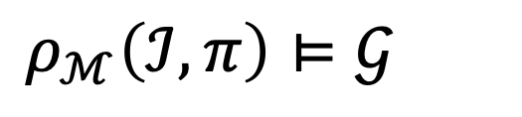

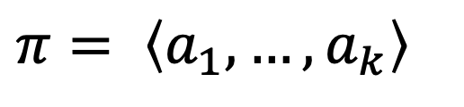
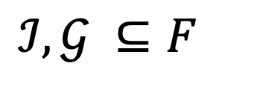
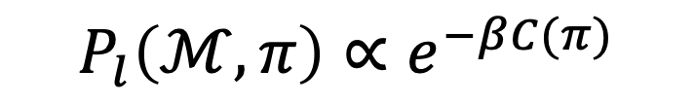
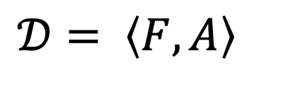
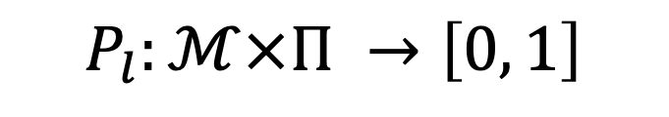
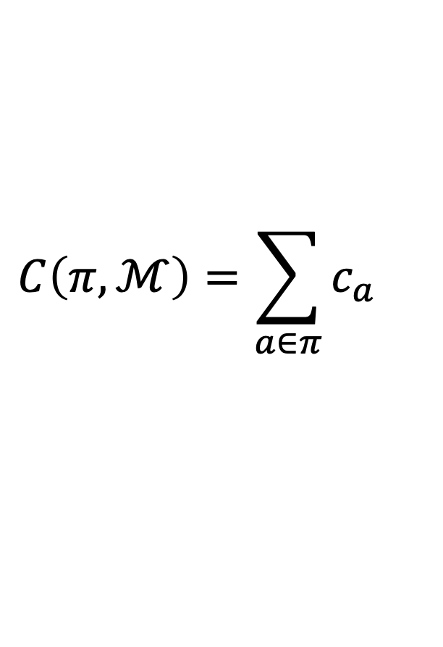
Example of Model
STRIPS style
$$ℳ= \left\langle 𝒟,ℐ,𝒢\right\rangle$$
$$𝒟= \left\langle F, A\right\rangle$$
$$ℐ, 𝒢 ⊆F$$
A plan for such model
$$π= \left\langle a_{1},…,a_{k}\right\rangle$$
Likelihood of a plan given a model
Cost of a plan
$$ρ_{ℳ}\left(ℐ, π\right)⊨𝒢$$
$$P_{l}:ℳ×Π →\left[0, 1\right]$$
$$C\left(π,ℳ\right)=\sum_{a∈π}{c_{a}}$$
$$P_{l}\left(ℳ,π\right)∝e^{−βC(π)}$$
Notes:
STRIPS style planning problem
D domain of the model that consist of fluent and actions
A plan for such models is a sequence of actions π = ⟨a1, ..., ak⟩,
When executed in the initial state leads to the goal ρM(I, π) |= G
C(π,M) = P a∈π ca
likelihood of a plan given a model
Common choice can be Boltzmann distribution of the cost of that plan

Slide 25
Agenda
Mental Model Based Framework of Trust
Interaction Settings
Trust in Mental Model States
Three trust information within framework
Developing Decision Making Frameworks Monitoring and Trust
How a designer can use the framework (Single interaction)
How a robot can use the framework (Iterated Interaction) Evaluating Trust Inference
Inferring trust dynamic
Controlling perceptions of trust
Other Research Contributions

Slide 26
Trust in Mental Model States
Trust as a measure is best understood in terms of one’s expectation on an agent to satisfy some specific contract [Jacovi, et al., 2021]
[Jacovi, et al., 2021] Formalizing trust in artificial intelligence: Prerequisites, causes and goals of human trust in ai.

Slide 27
Trust in Mental Model States
Trust as a measure is best understood in terms of one’s expectation on an agent to satisfy some specific contract [Jacovi, et al., 2021]
The agent’s behavior meeting some specific performance, process or purpose guarantee

Slide 28
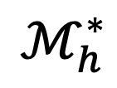
Trust in Mental Model States
Trust as a measure is best understood in terms of one’s expectation on an agent to satisfy some specific contract [Jacovi, et al., 2021]
The agent’s behavior meeting some specific performance, process or purpose guarantee
$$ℳ_{h}^{∗}$$
Notes:
This contract $𝒞$, is formed by the human based on their model $ℳ_{h}^{∗}$

Slide 29
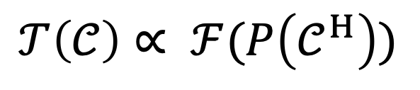
Trust in Mental Model States
Trust as a measure is best understood in terms of one’s expectation on an agent to satisfy some specific contract [Jacovi, et al., 2021]
The agent’s behavior meeting some specific performance, process or purpose guarantee
$$ℳ_{h}^{∗}$$
$$𝒯\left(𝒞\right)∝ ℱ(P\left(𝒞^{H}\right))$$

Slide 30
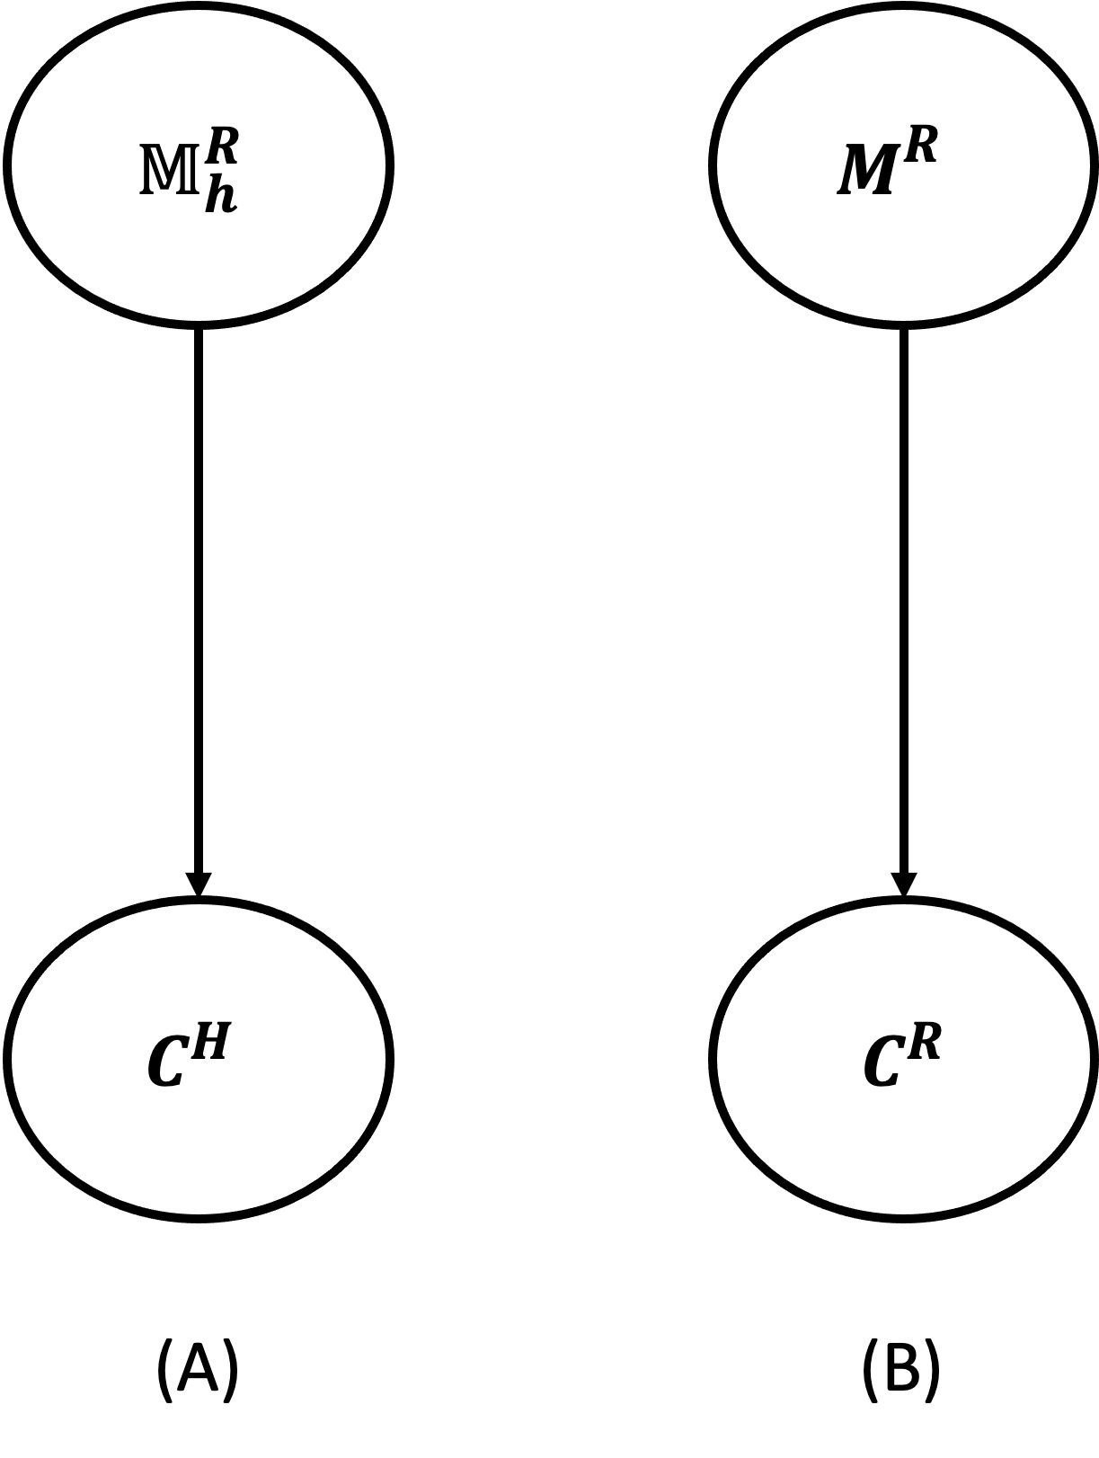
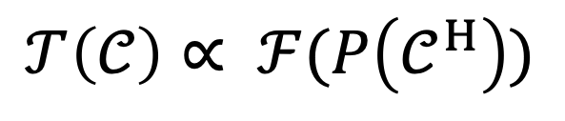
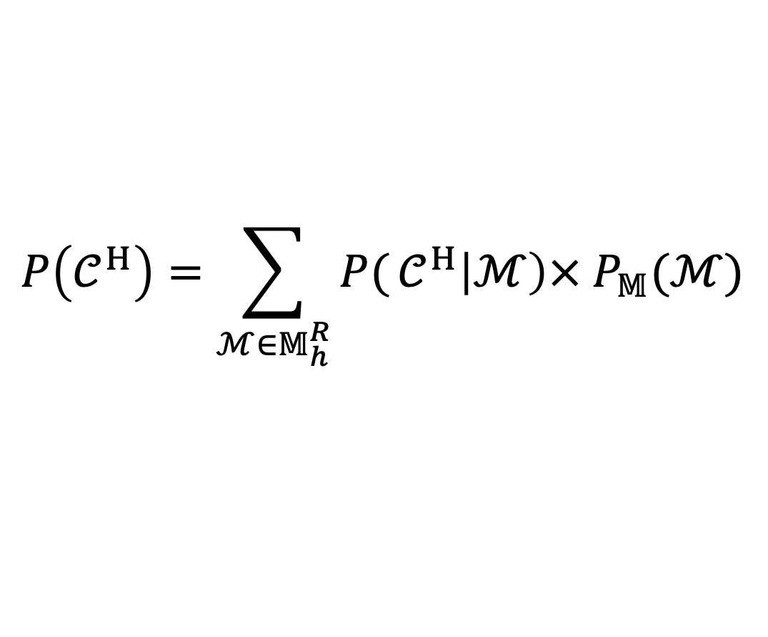
Formalizing Trust
Trust is modeled as a function of
$$𝒯\left(𝒞\right)∝ ℱ(P\left(𝒞^{H}\right))$$
Where
$$P\left(𝒞^{H}\right)=\sum_{{ℳ∈𝕄}_{h}^{R}}{P(}𝒞^{H}\left|ℳ\right)× P_{𝕄}(ℳ)$$
Notes:
CH is the random variable corresponding to the human belief that the contract will be satisfied)
P(CH |M) is the likelihood human associates with a model M coming up with a solution that can satisfy a given contract C

Slide 31
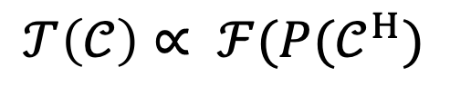
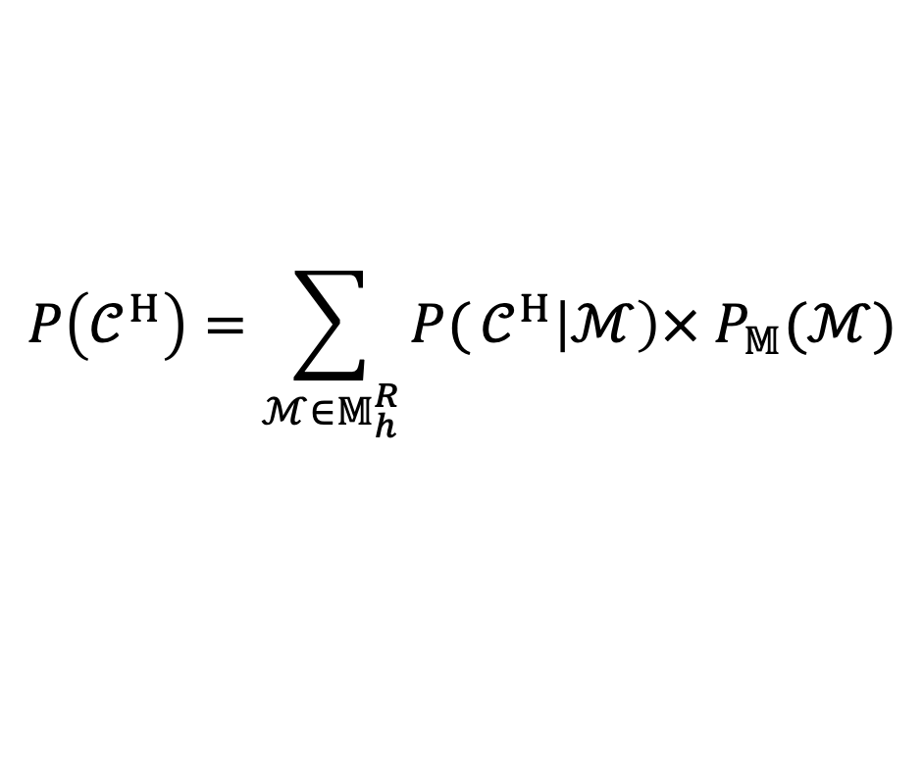
Modeling Trust Evolution
With new agent’s behavior or information, human update their posterior over the models the agents have
$$𝒯\left(𝒞\right)∝ ℱ(P(𝒞^{H})$$
$$P\left(𝒞^{H}\right)=\sum_{{ℳ∈𝕄}_{h}^{R}}{P(}𝒞^{H}\left|ℳ\right)× P_{𝕄}(ℳ)$$

Slide 32
Modeling Trust Evolution
With new agent’s behavior or information, human update their posterior over the models the agents have
$$𝒯\left(𝒞\right)∝ ℱ(P(𝒞^{H})$$
$$P\left(𝒞^{H}\right)=\sum_{{ℳ∈𝕄}_{h}^{R}}{P(}𝒞^{H}\left|ℳ\right)× P_{𝕄}(ℳ)$$

Slide 33
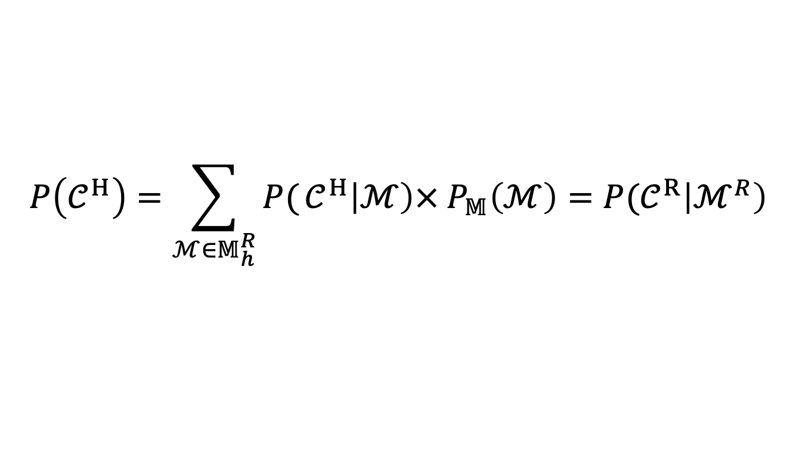
Appropriate Level of Trust
$$P\left(𝒞^{H}\right)=\sum_{{ℳ∈𝕄}_{h}^{R}}{P(}𝒞^{H}\left|ℳ\right)× P_{𝕄}\left(ℳ\right)=P(𝒞^{R}\left|ℳ^{R}\right)$$
Notes:
The level of trust the human has in an agent is appropriate if the likelihood the human associates with the system satisfying the contract is equal to the likelihood of the agent satisfying that contract
Where CR is the random variable associated with the robot actually achieving the contract.

Slide 34
Agenda
Mental Model Based Framework of Trust
Interaction Settings
Trust in Mental Model States
Three trust information within framework
Developing Decision Making Frameworks Monitoring and Trust
How a designer can use the framework (Single interaction)
How a robot can use the framework (Iterated Interaction) Evaluating Trust Inference
Inferring trust dynamic
Controlling perceptions of trust
Other Research Contributions

Slide 35
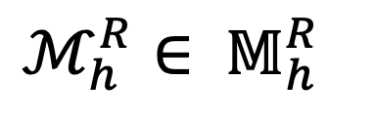
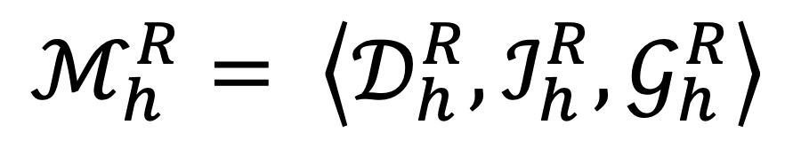
Three dimensions of Trust within the framework
$$ℳ_{h}^{R}= \left\langle 𝒟_{h}^{R},ℐ_{h}^{R},𝒢_{h}^{R}\right\rangle$$
$ℳ_{h}^{R}∈ 𝕄_{h}^{R}$
Notes:
formation of trust in humans is tightly bound with their mental models. The trust a human places in a robot is fundamentally linked to the interplay between their mental models (M∗h and MRh).

Slide 36
Three dimensions of Trust within the framework
Robot Capabilities
$$ℳ_{h}^{R}= \left\langle 𝒟_{h}^{R},ℐ_{h}^{R},𝒢_{h}^{R}\right\rangle$$
$ℳ_{h}^{R}∈ 𝕄_{h}^{R}$

Slide 37
Three dimensions of Trust within the framework
Robot Capabilities
$$ℳ_{h}^{R}= \left\langle 𝒟_{h}^{R},ℐ_{h}^{R},𝒢_{h}^{R}\right\rangle$$
$ℳ_{h}^{R}∈ 𝕄_{h}^{R}$
Performance

Slide 38
Three dimensions of Trust within the framework
Internal robot goal
Human’s requested goal
Robot Capabilities
$$ℳ_{h}^{R}= \left\langle 𝒟_{h}^{R},ℐ_{h}^{R},𝒢_{h}^{R}\right\rangle$$
$ℳ_{h}^{R}∈ 𝕄_{h}^{R}$
Performance

Slide 39
Three dimensions of Trust within the framework
Internal robot goal
Human’s requested goal
Robot Capabilities
$$ℳ_{h}^{R}= \left\langle 𝒟_{h}^{R},ℐ_{h}^{R},𝒢_{h}^{R}\right\rangle$$
$ℳ_{h}^{R}∈ 𝕄_{h}^{R}$
Performance
Purpose

Slide 40
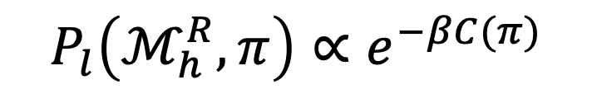
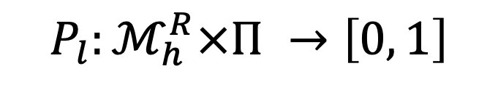
Three dimensions of Trust within the framework
Internal robot goal
Human’s requested goal
Robot Capabilities
$$ℳ_{h}^{R}= \left\langle 𝒟_{h}^{R},ℐ_{h}^{R},𝒢_{h}^{R}\right\rangle$$
$ℳ_{h}^{R}∈ 𝕄_{h}^{R}$
Performance
Purpose
$$P_{l}:ℳ_{h}^{R}×Π →\left[0, 1\right]$$
$$P_{l}\left(ℳ_{h}^{R},π\right)∝e^{−βC(π)}$$
Notes:
Maximum probability will be the optimal plan in that model

Slide 41
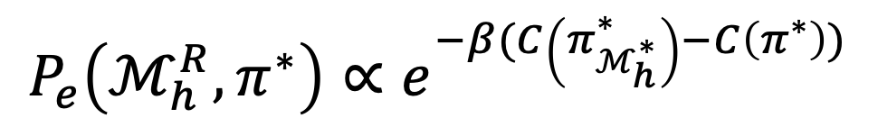
Three dimensions of Trust within the framework
Internal robot goal
Human’s requested goal
Robot Capabilities
$$ℳ_{h}^{R}= \left\langle 𝒟_{h}^{R},ℐ_{h}^{R},𝒢_{h}^{R}\right\rangle$$
$ℳ_{h}^{R}∈ 𝕄_{h}^{R}$
Performance
Purpose
$$P_{l}:ℳ_{h}^{R}×Π →\left[0, 1\right]$$
How close a robot plan is to the plan expected by human
$$P_{l}\left(ℳ_{h}^{R},π\right)∝e^{−βC(π)}$$
$$P_{e}\left(ℳ_{h}^{R},π^{∗}\right)∝e^{−β(C\left(π_{ℳ_{h}^{∗}}^{∗}\right)−C\left(π^{∗}\right))}$$
Process

Slide 42
Agenda
Mental Model Based Framework of Trust
Interaction Settings
Trust in Mental Model States
Three trust information within framework
Developing Decision Making Frameworks Monitoring and Trust
How a designer can use the framework (Single interaction)
How a robot can use the framework (Iterated Interaction) Evaluating Trust Inference
Inferring trust dynamic
Controlling perceptions of trust
Other Research Contributions

Slide 43
Agenda
Mental Model Based Framework of Trust
Interaction Settings
Trust in Mental Model States
Three trust information within framework
Developing Decision Making Frameworks Monitoring and Trust
How a designer can use the framework (Single interaction)
How a robot can use the framework (Iterated Interaction) Evaluating Trust Inference
Inferring trust dynamic
Controlling perceptions of trust
Other Research Contributions

Slide 44
Concretizing the Framework
Human Supervisor
Monitor or
Not monitor
Intervene or
Not Intervene
Robot Performer

Slide 45
Human Trust and Monitoring Interplay
Motivation
Trust and monitoring are related
Not monitoring the robot implies accepting the risk and vulnerability
Operationalization of the relationship between trust and monitoring can be useful to avoid automation bias and complacency
It can be used in other human-AI decision making frameworks
Approach
Human study to collect data for monitoring and trust
Evaluating the interplay between two variables
Fitting models that can capture the interplay and predict one variable based on the other
Z. Zahedi, S Sreedharan, M Verma, S Kambhampati,“Modeling the Interplay between Human Trust and Monitoring” in proceeding of HRI 2022
Notes:
Low trust make to observe to adjust trust and high trust no observation

Slide 46
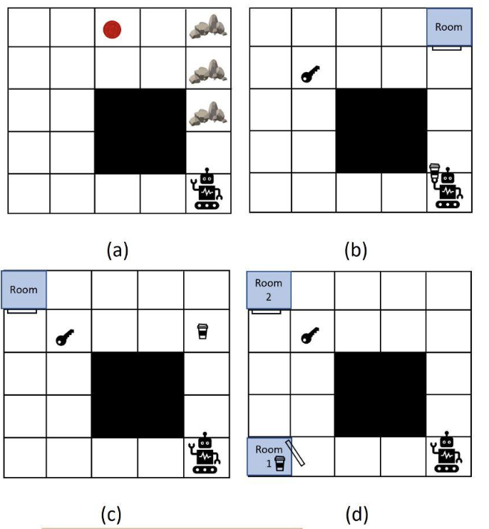
Human Subject Studies
62 participants
Office domain
Robot has 4 tasks
10 rounds of monitoring vs image labeling
Measuring trust by Muir questionnaire
Collecting monitoring choices
robot objective here includes (a) to reach the red point, (b,c) to bring the coffee to the room, (d) to move coffee from room 1 to room 2.
Notes:
62 participants) to collect the data for learning the models.
(in terms of reaching the goal, reaching it optimally, reaching it explicably etc.)—each of which affect that affect their trust in the robot in subsequent rounds.
We gamified the setting by informing the users that depending on the choices they make; they will either gain or lose points (the participants are informed about the exact points they may receive for each choice).

Slide 47
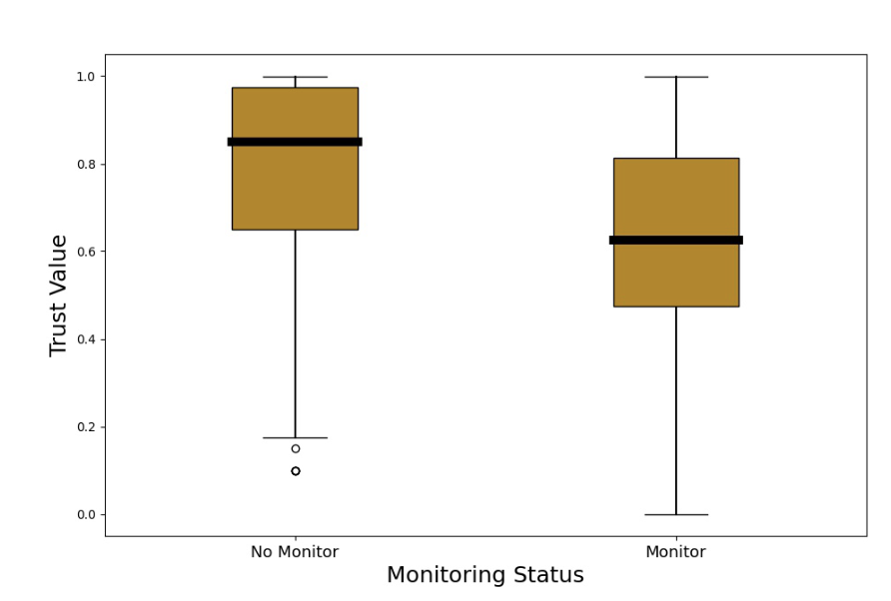
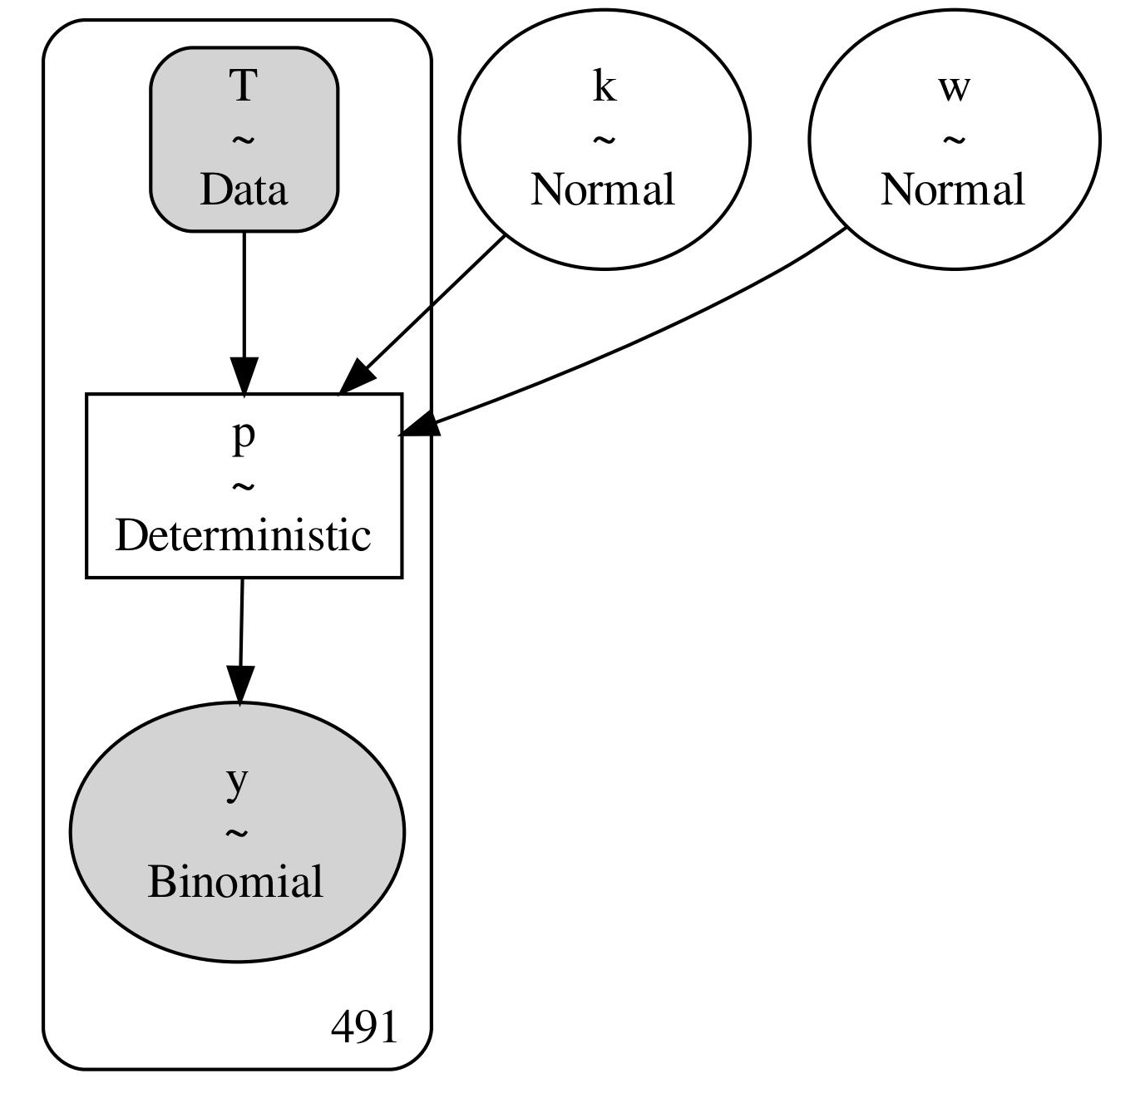
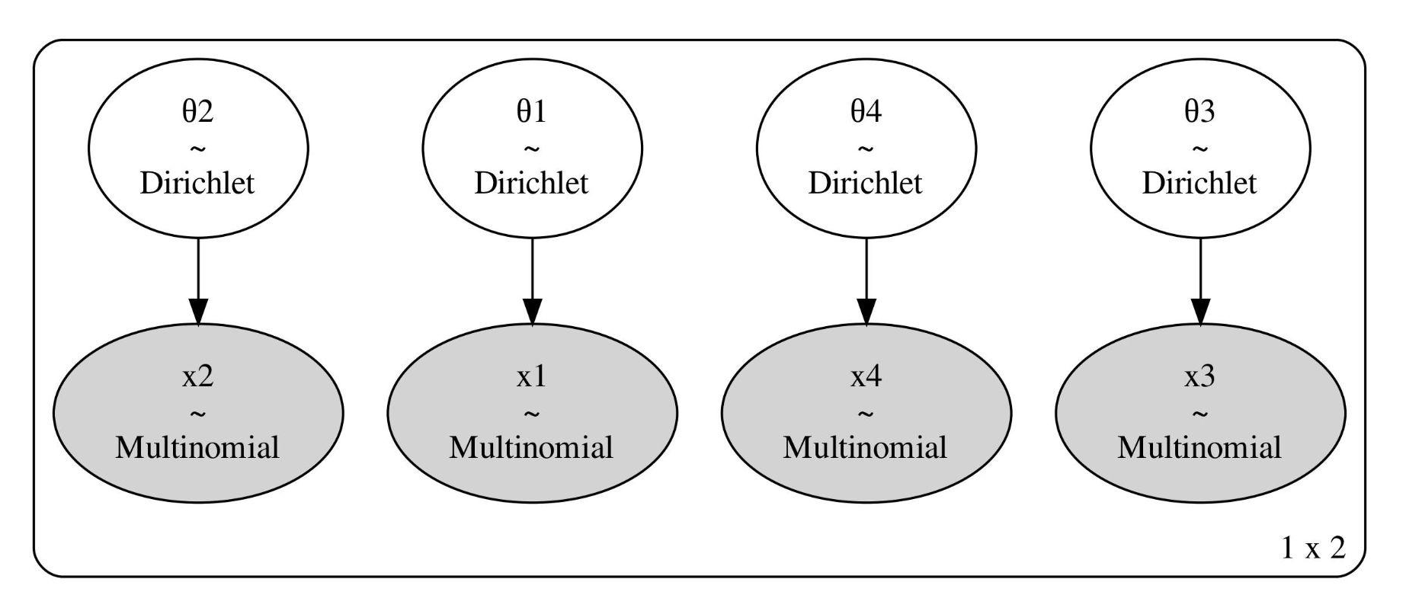
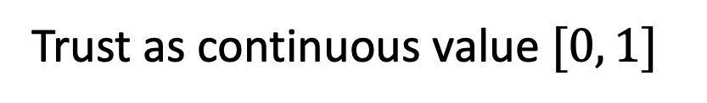
Models and Results
With higher trust → more people chose not to monitor the robot.
Trust as continuous value $[0, 1]$
4 levels of trust
Probability of monitoring given any trust value
Probability of monitoring at each trust level
Notes:
We tested whether there exists any relationship between human’s trust and monitoring and measure the strength of association between them
Box plot shows that with higher trust, more people chose not to monitor the robot.
Negative correlation that is statistically significant

Slide 48
Agenda
Mental Model Based Framework of Trust
Interaction Settings
Trust in Mental Model States
Three trust information within framework
Developing Decision Making Frameworks Monitoring and Trust
How a designer can use the framework (Single interaction)
How a robot can use the framework (Iterated Interaction) Evaluating Trust Inference
Inferring trust dynamic
Controlling perceptions of trust
Other Research Contributions

Slide 49
How a designer can use the framework
Computational models
Human factor views
Decision making frameworks
Perceptions and characteristics
Structure
Inference
Human
Designer
Robot
Trust change
diff perceptions
AAMAS’ 19; Trust R:SS’ 21; R4P
Under-rev. THMS
Single
Interaction
Longitudinal

Slide 50
How a designer can use the framework
Motivation
Single interaction with no warranted trust
Human have to always monitor the robot
Robot’s behavior may deviate from human’s expectations
Z. Zahedi, S. Sengupta, S. Kambhampati,“Inference of Human's Observation Strategy for Monitoring Robot's Behavior based on a Game-Theoretic Model of Trust” AAMAS 2019 (Trust workshop), R:SS2021 (R4P), and under review at IEEE THMS
Notes:
Conventional wisdom often guides the supervisor to spend all their time monitoring the robot’s behavior to ensure that it adheres to their expectations
an autonomous car ride-sharing (or, in general, robot-as-a-service) may have certain expectations from its supervisor (eg. travel on shortest routes) but may need to adhere to passenger’s expectation (eg. avoid hilly roads) that are in conflict with one another
resource-efficient monitoring strategies for human in the absence of trust
human’s exact model M∗h, but has knowledge about set of human model of the robot MRh that captures all the possible set of safety constraints the human might have

Slide 51

How a designer can use the framework
Motivation
Single interaction with no warranted trust
Human have to always monitor the robot
Robot’s behavior may deviate from human’s expectations
https://depositphotos.com/
Robot with side goals (not align with human)
Z. Zahedi, S. Sengupta, S. Kambhampati,“Inference of Human's Observation Strategy for Monitoring Robot's Behavior based on a Game-Theoretic Model of Trust” AAMAS 2019 (Trust workshop), R:SS2021 (R4P), and under review at IEEE THMS
Notes:
Conventional wisdom often guides the supervisor to spend all their time monitoring the robot’s behavior to ensure that it adheres to their expectations
an autonomous car ride-sharing (or, in general, robot-as-a-service) may have certain expectations from its supervisor (eg. travel on shortest routes) but may need to adhere to passenger’s expectation (eg. avoid hilly roads) that are in conflict with one another
resource-efficient monitoring strategies for human in the absence of trust
human’s exact model M∗h, but has knowledge about set of human model of the robot MRh that captures all the possible set of safety constraints the human might have

Slide 52
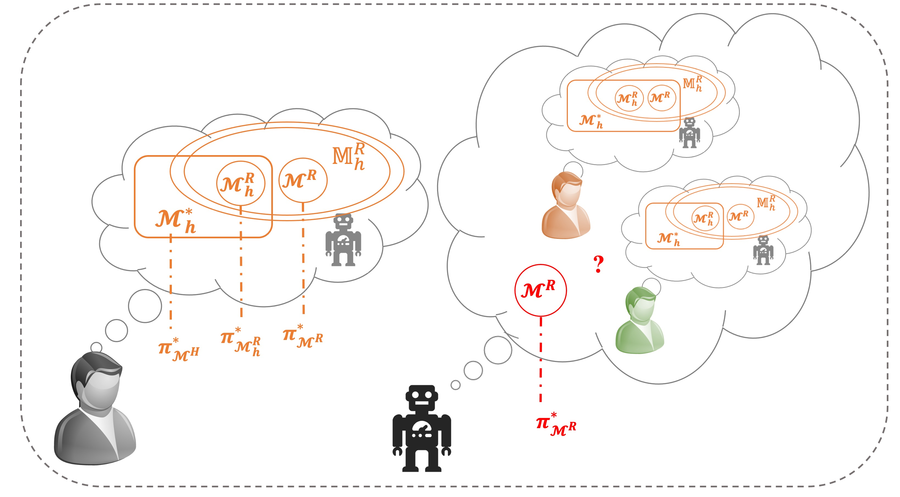
How a designer can use the framework
Motivation
Single interaction with no warranted trust
Human have to always monitor the robot
Robot’s behavior may deviate from human’s expectations
https://depositphotos.com/
Robot with side goals (not align with human)
Robot may not be aware of the human’s exact model
Human doesn’t monitor → A less costly plan but unsafe
Z. Zahedi, S. Sengupta, S. Kambhampati,“Inference of Human's Observation Strategy for Monitoring Robot's Behavior based on a Game-Theoretic Model of Trust” AAMAS 2019 (Trust workshop), R:SS2021 (R4P), and under review at IEEE THMS
Notes:
Conventional wisdom often guides the supervisor to spend all their time monitoring the robot’s behavior to ensure that it adheres to their expectations
an autonomous car ride-sharing (or, in general, robot-as-a-service) may have certain expectations from its supervisor (eg. travel on shortest routes) but may need to adhere to passenger’s expectation (eg. avoid hilly roads) that are in conflict with one another
resource-efficient monitoring strategies for human in the absence of trust
human’s exact model M∗h, but has knowledge about set of human model of the robot MRh that captures all the possible set of safety constraints the human might have

Slide 53
How a designer can use the framework
Approach
A monitoring strategy for the human to save resources and ensure safe behavior that achieves the goal
Game-theoretic model of trust
Trust boundary
Z. Zahedi, S. Sengupta, S. Kambhampati,“Inference of Human's Observation Strategy for Monitoring Robot's Behavior based on a Game-Theoretic Model of Trust” AAMAS 2019 (Trust workshop), R:SS2021 (R4P), and under review at IEEE THMS
Notes:
The uncertainty about the models
resource-efficient monitoring strategies for human in the absence of trust

Slide 54

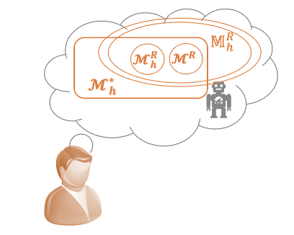
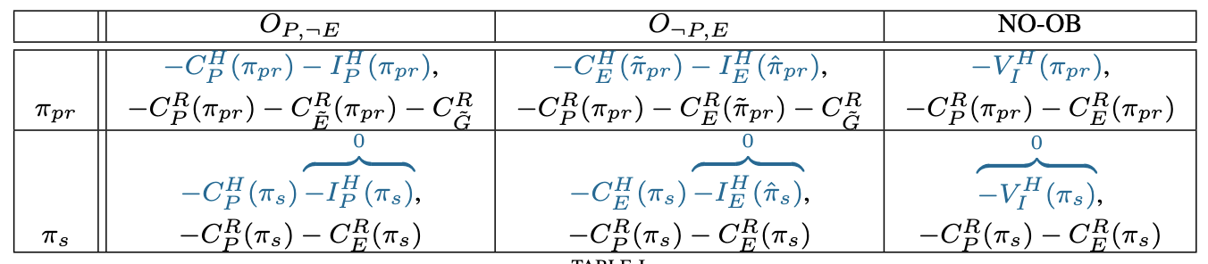
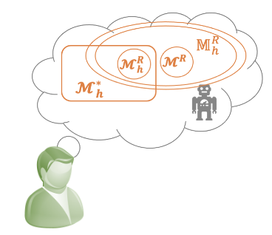

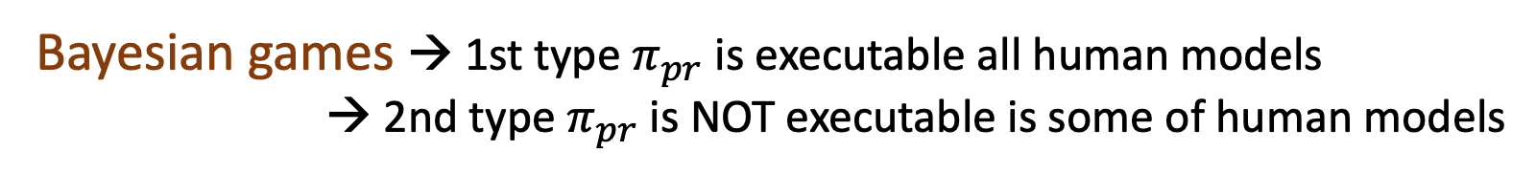
Problem Formulation
TRUST; Vulnerability
Bayesian games → 1st type $π_{pr}$ is executable all human models
→ 2nd type $π_{pr}$ is NOT executable is some of human models
Fraction that human can choose to monitor or not monitor the robot
Trust boundary
Assure the robot will stick to safe plan
Notes:
Some consideration over costs. For example cost of planning is higher than executing and monitoring it would be similar
the expected utility of robot for the safe plan under human observation strategy should always be more that the expected utility of robot for the probably risky plan

Slide 55


Human Subject Studies
Two human subject studies
Study I: Do we need this service?
Study II: Does this service help?
H1- Human monitoring strategies are inferior to optimal strategy ( lower cost while ensuring safe robot behavior)
H2- Humans deviate from continuous robot monitoring (leading to unsafe robot behaviors).
H3- Providing humans with the optimal monitoring strategy improves their monitoring approach.

Slide 56
Agenda
Mental Model Based Framework of Trust
Interaction Settings
Trust in Mental Model States
Three trust information within framework
Developing Decision Making Frameworks Monitoring and Trust
How a designer can use the framework (Single interaction)
How a robot can use the framework (Iterated Interaction) Evaluating Trust Inference
Inferring trust dynamic
Controlling perceptions of trust
Other Research Contributions

Slide 57
How a robot can use the framework
Computational models
Human factor views
Decision making frameworks
Perceptions and characteristics
Structure
Inference
Human
Designer
Robot
Trust change
diff perceptions
HRI’ 22; lbr
HRI’ 23
ICAPS’ 20, XAIP
Single
Interaction
Longitudinal

Slide 58
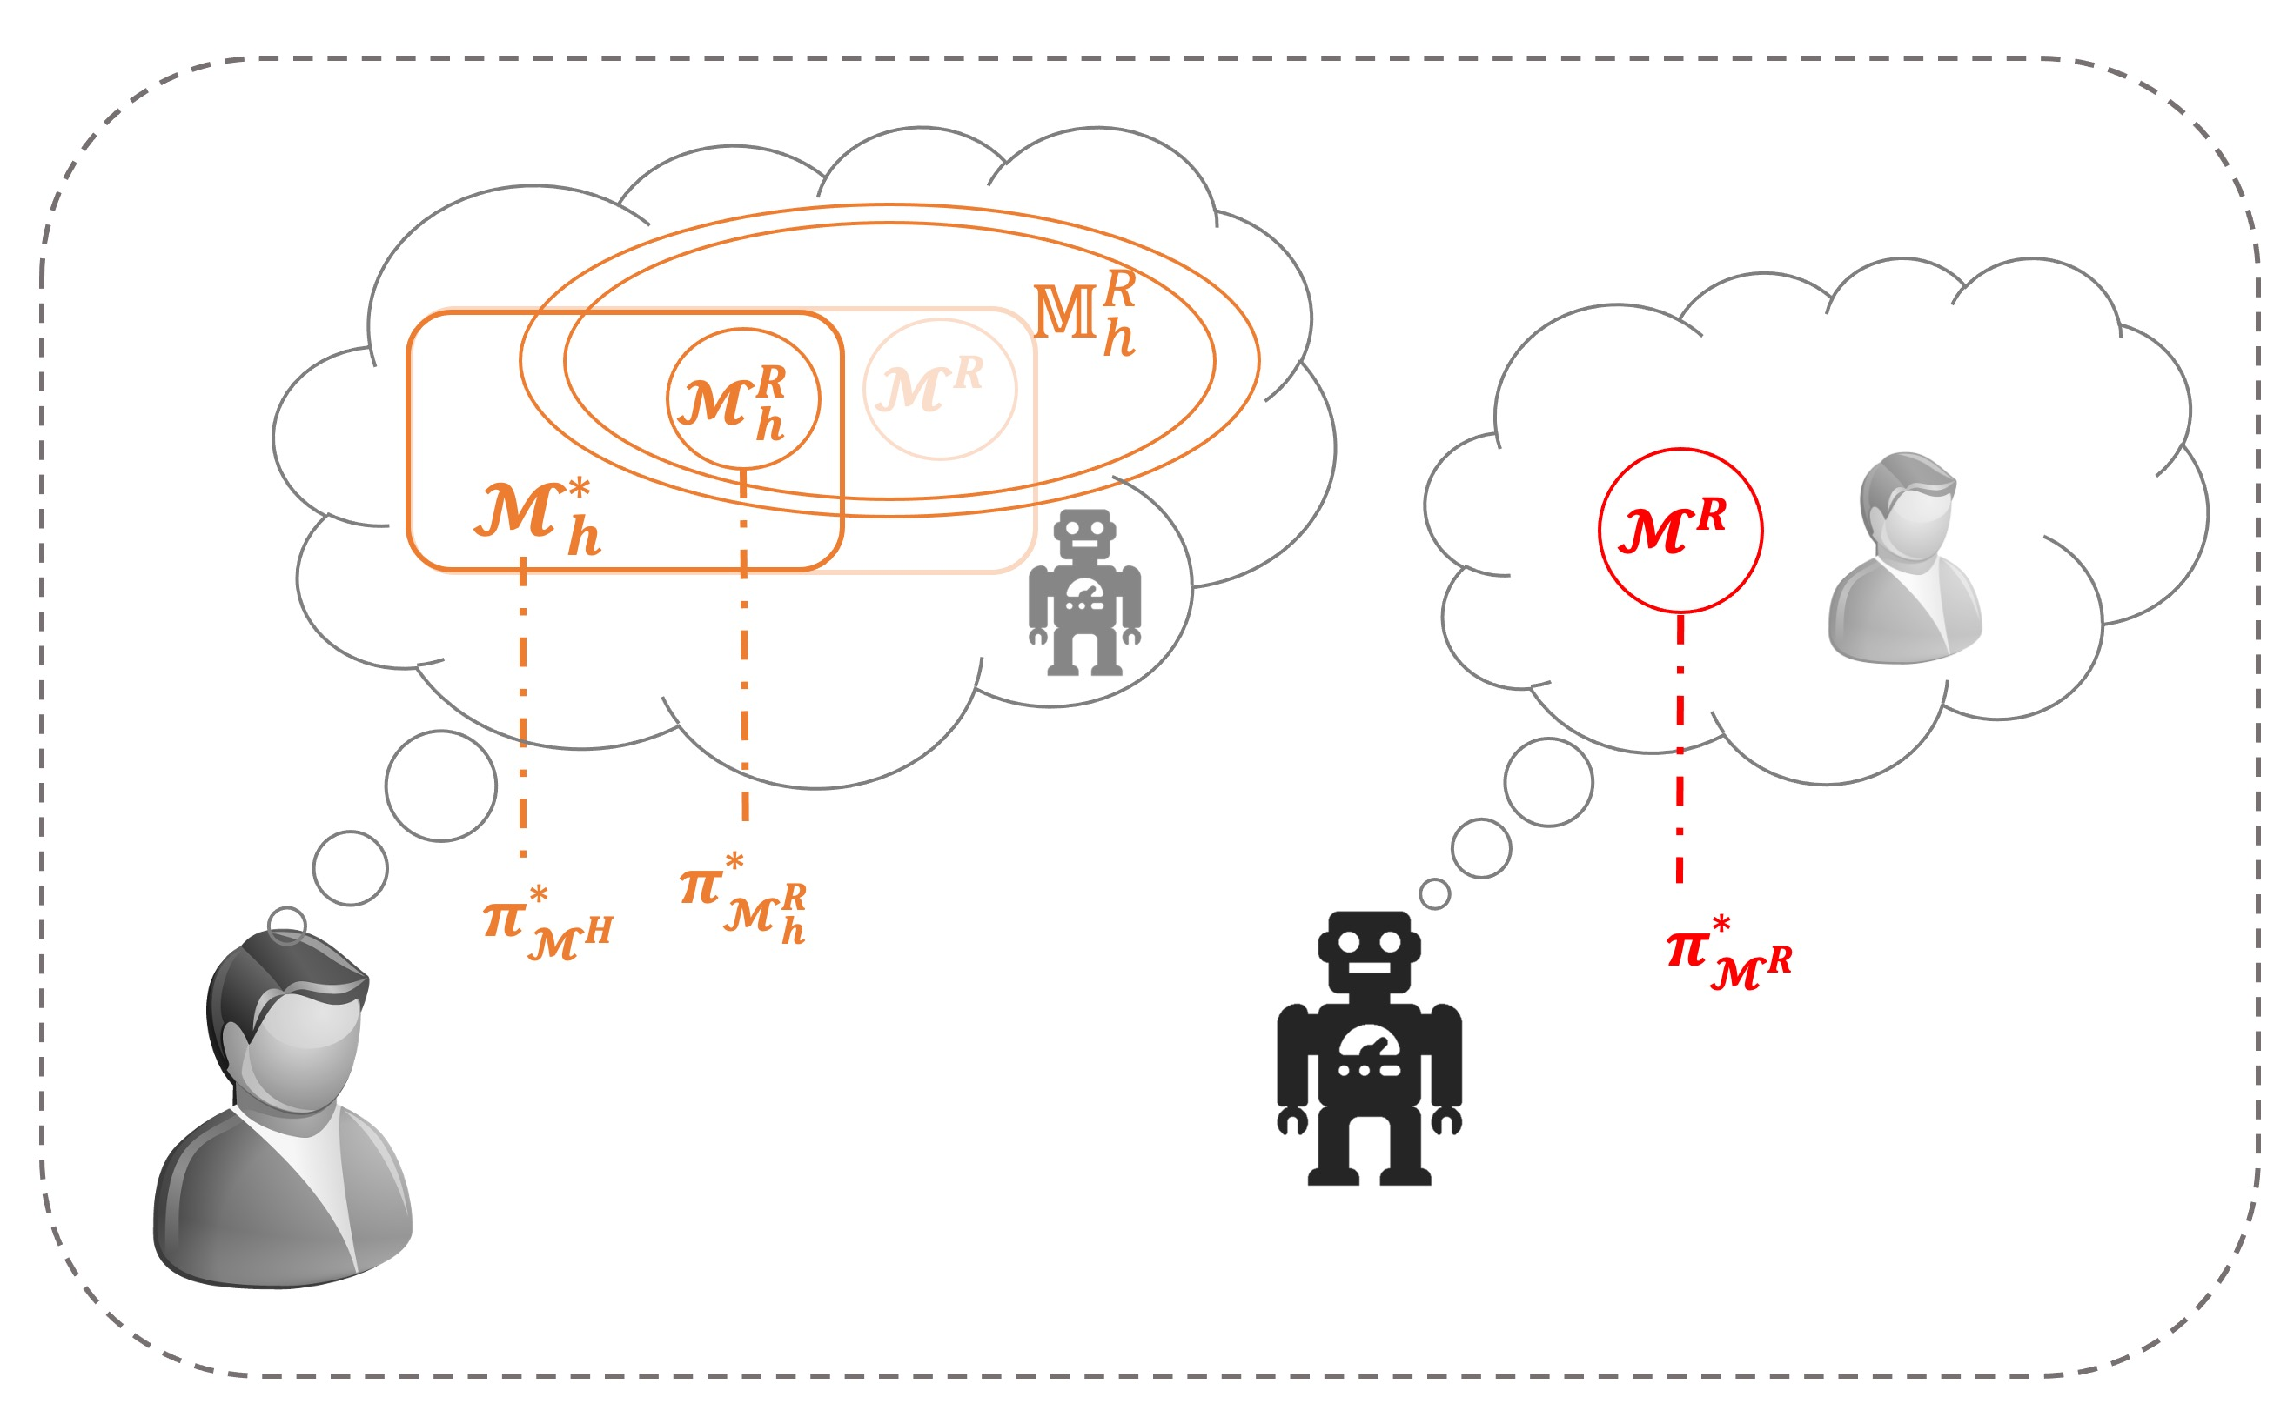
Iterated Interaction
Motivation
Iterated interaction of human and robot
Human has different model of the robot than the robot model of task
Explicable behavior is costly but trust friendly
A trade-off is needed for expensive but trust engendering behavior, and efficient but possibly surprising behavior
Z. Zahedi, M Verma, S Sreedharan, S Kambhampati,“Trust-Aware Planning: Modeling Trust Evolution in Iterated Human-Robot Interaction” HRI 2023
Notes:
Can engender trust
If the robot optimal inline with human then it can be easily engengered
But if the models are different then explicable is costly

Slide 59
Iterated Interaction
Motivation
Iterated interaction of human and robot
Human has different model of the robot than the robot model of task
Explicable behavior is costly but trust friendly
A trade-off is needed for expensive but trust engendering behavior, and efficient but possibly surprising behavior
Approach
Meta-computational framework that can model and work with the user’s trust
Taking a longitudinal view of the teaming to choose to be optimal, explicable or explain
Z. Zahedi, M Verma, S Sreedharan, S Kambhampati,“Trust-Aware Planning: Modeling Trust Evolution in Iterated Human-Robot Interaction” HRI 2023

Slide 60

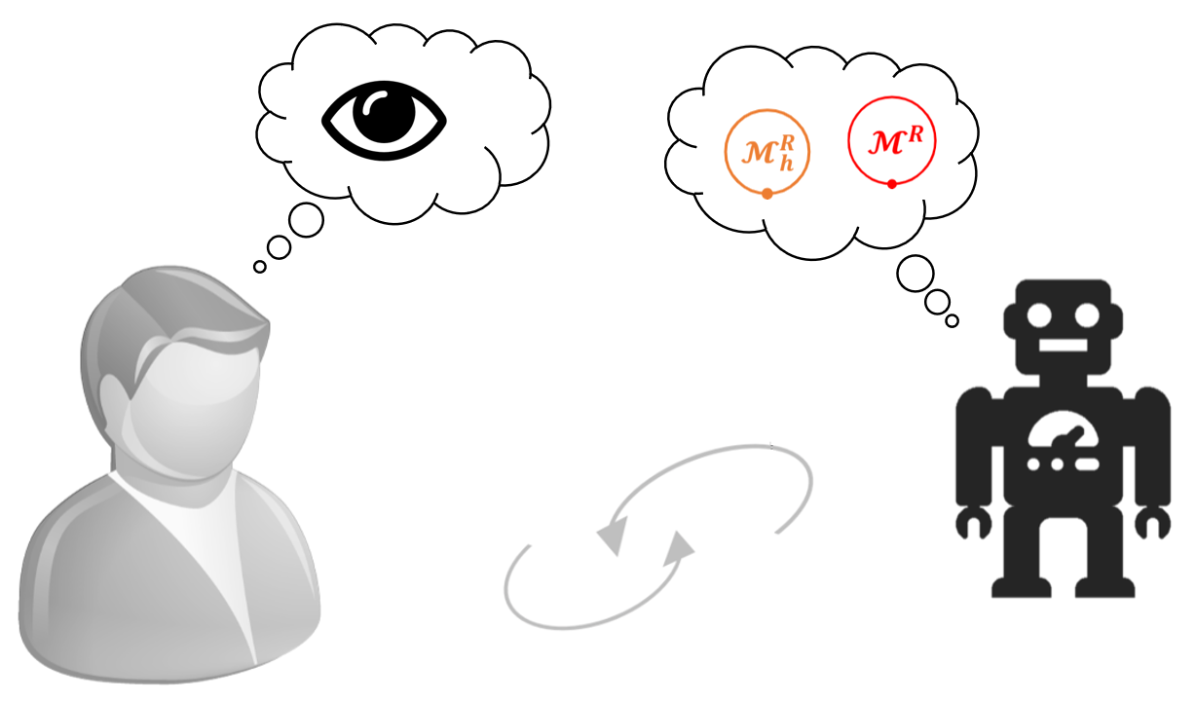



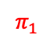
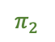
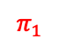
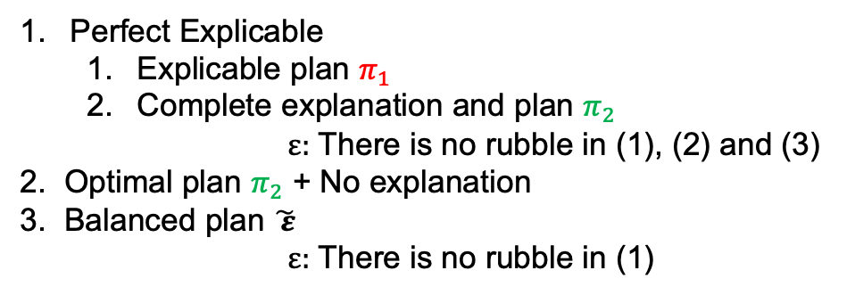
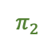
Human Expectation: Explicable/Explanation
Human model
Robot model
$$π_{2}$$
(3)
$$π_{1}$$
$$π_{1}$$
$$π_{2}$$
(2)
(1)
Perfect Explicable
Explicable plan $π_{1}$
Complete explanation and plan $π_{2}$
$ε:$ There is no rubble in (1), (2) and (3)
2. Optimal plan $π_{2}$ + No explanation
3. Balanced plan $\tilde{ ε}$
$ε:$ There is no rubble in (1)

Slide 61
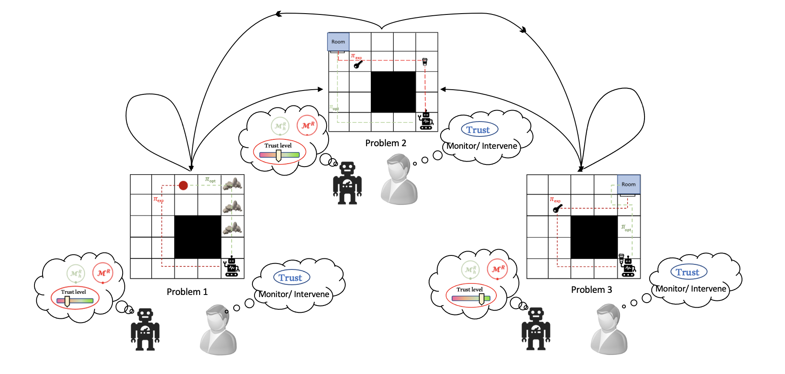
Trust-Aware Model
Robot maintains a computation model of human trust and their expectations in longitudinal interaction
Notes:
A computational model for capturing and modulating trust in longitudinal human-robot interaction
The robot integrates human’s trust and their expectations into planning to build and maintain trust over the interaction horizon
The human with a high level of trust in the robot, might choose not to monitor the robot, or not to intervene by stopping the robot
By establishing the required level of trust, the robot can focus on maximizing the team goal by eschewing explicit explanatory or explicable behavior

Slide 62
Trust-Aware Model
Robot maintains a computation model of human trust and their expectations in longitudinal interaction
The reasoning about trust levels is modeled as a meta reasoning process over individual planning tasks
Notes:
A computational model for capturing and modulating trust in longitudinal human-robot interaction
The robot integrates human’s trust and their expectations into planning to build and maintain trust over the interaction horizon
The human with a high level of trust in the robot, might choose not to monitor the robot, or not to intervene by stopping the robot
By establishing the required level of trust, the robot can focus on maximizing the team goal by eschewing explicit explanatory or explicable behavior

Slide 63
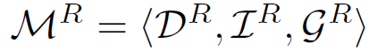
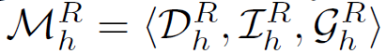
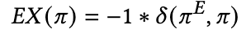

Problem Formulation: Base Level
Base Decision-Making Problem
Each individual task a human-aware planning (HAP) problem of the form $⟨ℳ^{R}, ℳ_{h}^{R}⟩$
The degree to which the plan meets the user expectation → the explicability score of the plan
Plans:
Perfect Explicable $π_{exp}$ → explicable plan or complete explanation
Balanced explicable $π_{bal}$ → partial explanation
Optimal Plan $π_{opt}$
Distance between Current plan and Expected plan
Notes:
common choice for the distance is the cost difference in the human’s model for the expected plan, and the optimal plan in the human model

Slide 64


Problem Formulation: Meta Level MDP
Meta-MDP Problem
This captures the longitudinal reasoning process
State space: Trust level of the human ($s_{i})$
Action space: Base-level strategies ($π_{exp}$, $π_{bal}$, $π_{opt}$)
Transition function:
Robot’s behavior
Human’s monitoring strategy $ω\left(i\right)$
Explicability score
This process is used by the robot to decide whether to be explicable, provide an explanation or be optimal
Cost function:
$$ℂ \left(s_{i}, a^{π}\right)=1− ω\left(i\right)∗C_{e}\left(π\right)+ω\left(i\right)∗C_{{<ℳ}^{R}, ℳ_{h}^{R}>}$$
$C_{e}\left(π\right)$ full execution cost
$C_{{<ℳ}^{R}, ℳ_{h}^{R}>}$ executing a strategy under monitoring
Notes:
Human’s monitoring strategy (trust → probability of monitoring $ω\left(i\right)$)
\Depends on the
Consist of cost of executing the plan till the point of intervention and penalty of not completing the goal

Slide 65

Human Subject Studies: Setup
79 participants
Office domain
Trust-aware vs 3 baselines – always explicable, always optimal,
random policy
robot objective here includes (a) to reach the red point, (b,c) to bring the coffee to the room, (d) to move coffee from room 1 to room 2.
Notes:
Study performed in the office domain

Slide 66


Results
Hypotheses
t-test and mixed ANOVA
H1- Team performance → trust-aware > always explicable
H2- Engendered trust → trust-aware > random policy
H3- Engendered trust → trust-aware > always optimal
Z. Zahedi, M Verma, S Sreedharan, S Kambhampati,“Trust-Aware Planning: Modeling Trust Evolution in Iterated Human-Robot Interaction” HRI 2023
Notes:
We validated our hypotheses by applying

Slide 67
Agenda
Mental Model Based Framework of Trust
Interaction Settings
Trust in Mental Model States
Three trust information within framework
Developing Decision Making Frameworks Monitoring and Trust
How a designer can use the framework (Single interaction)
How a robot can use the framework (Iterated Interaction) Evaluating Trust Inference
Inferring trust dynamic
Controlling perceptions of trust
Other Research Contributions

Slide 68
Evaluating Trust Inference
Computational models
Human factor views
Decision making frameworks
Perceptions and characteristics
Structure
Inference
Human
Designer
Robot
Trust change
diff perceptions
IJCAI’23, XAI
Single
Interaction
Longitudinal

Slide 69
Mental Model based Theory of Trust
Motivation
Our mental model-based framework effectively captured the structure and formulation
Measuring Trust is not practically feasible
Necessity to infer trust and understand the dynamics of trust changes
Approach
User studies to evaluate the model ability to infer the changes in trust and different perceptions of trust
Z. Zahedi, S Sreedharan, S Kambhampati,“A Mental Model Based Theory of Trust”, XAI workshop at IJCAI 2023
Notes:
Used as a basis to develop alternate approaches to

Slide 70





Inferring Dynamic of Trust
$$𝒯\left(𝒞\right)∝ ℱ(P(𝒞^{H})$$
$$P\left(𝒞^{H}\right)=\sum_{{ℳ∈𝕄}_{h}^{R}}{P(}𝒞^{H}\left|ℳ\right)× P_{𝕄}(ℳ)$$
$$𝒟_{h}^{R}$$
Performance
$$P_{e}\left(ℳ_{h}^{R},π^{∗}\right)$$
Process
Mental model state of interaction
$$𝒢_{h}^{R}$$
Purpose
Z. Zahedi, S Sreedharan, S Kambhampati,“A Mental Model Based Theory of Trust”, XAI workshop at IJCAI 2023

Slide 71
Evaluation: Inferring changes in Trust
Approach: Set of human subject studies
Positive model update → increase in trust
Negative model update → decrease in trust
Updating models corresponding to various information of trust will cause an update in associated perception of trust
Comparing the updates with trust questionnaire that can capture different information of trust

Slide 72
Hypotheses and Conditions
Hypotheses
H1- Updated trust in positive vs. negative group are different
H2- Positive update group →
Increase in trust
H3- Negative update group →
Decrease in trust
H4- Performance perception changes more in S1
H5- Process perception changes more in S2
H6- Purpose perception changes more in S3
Two groups → positive update
negative update
Three Scenarios → Performance (S1)
Process (S2)
Purpose (S3)

Slide 73





Scenarios
Scenarios:
Performance (S1) Process (S2) Purpose (S3)
Task: Help the friend (black T-shirt) to stack the block
Equally likely possible robots:
1. Satisfying user’s goal is the robot's objective.
2. Satisfying user’s goal is not the robot's objective.
Task: Stack purple block on red
Information: Purple block is heavy
Equally likely possible robots:
1. can pick up heavy block
2. cannot pick up heavy block
Task: put a purple block in the bowl
Information: There are two purple block
$$𝕄_{h}^{R}$$
$$𝕄_{h}^{R}$$

Slide 74


Updates
Scenario:
Updates:
Performance (S1)
Positive update
8X speed
Task: Stack purple block on red
Information: Purple block is heavy
Equally likely possible robots:
1. can pick up heavy block
2. cannot pick up heavy block
Negative update

Slide 75


Updates
Scenario:
Updates:
Process (S2)
Positive update
8X speed
Task: put a purple block in the bowl
Information: There are two purple block
Negative update

Slide 76


Updates
Scenario:
Updates:
Purpose (S3)
Positive update
20X speed
Task: Help the friend (black T-shirt) to stack the block
Equally likely possible robots:
1. Satisfying user’s goal is the robot's objective.
2. Satisfying user’s goal is not the robot's objective.
Negative update

Slide 77

Trust Questionnaire
[Chancey, et al., 2017] Trust and the compliance–reliance paradigm: The effects of risk, error bias, and reliability on trust and dependence.

Slide 78
Results

Slide 79



Results

Slide 80

Results: All Scenarios

Slide 81
Results: Takeaways
All scenarios
Performance (S1)
Purpose (S3)
Process (S2) → only process perception
H1
H4
Positive update → performance
H5
All scenarios
Performance (S1)
Process (S2)
Purpose (S3)
Negative update → Process
H2
Positive update → performance
H6
All scenarios → purpose perception and total trust
Performance (S1)
Process (S2) → Increase!!
Negative update → Purpose
H3

Slide 82
Results: Takeaways
Positive update in model → Increase trust
Negative update in model → Decrease trust
Updating models for specific trust-related information correlated with that specific trust perception → Especially in negative update
Negative update in process increased trust:
1. Comes with positive update in other perception
2. Process can include both observability and preference
3. Excluding one perception without others is challenging
The significance of performance shows:
1. Performance perception is more effective in trust
2. Assuming performance is byproduct of aligned purpose and effective process

Slide 83
Agenda
Mental Model Based Framework of Trust
Interaction Settings
Trust in Mental Model States
Three trust information within framework
Developing Decision Making Frameworks Monitoring and Trust
How a designer can use the framework (Single interaction)
How a robot can use the framework (Iterated Interaction) Evaluating Trust Inference
Inferring trust dynamic
Controlling perceptions of trust
Other Research Contributions

Slide 84

Other Research Contributions: AITA
AI Task Allocator for team of human
Humans might contest AITA’s allocation by a counterfactual Agent with imperfect knowledge
Agent with limited computational capability
A contrastive explanation is provided → the proposed allocation is better than the counterfactual.
AITA uses a negotiation process that produces a negotiation-aware task allocation and contrastive explanation.
Human studies show AITA’s allocation is fair and the explanation is understandable and convincing.
Z. Zahedi, S sengupta, S Kambhampati,“'Why didn't you allocate this task to them? 'Negotiation-Aware Explicable Task Allocation and Contrastive Explanation Generation,” In Proceedings AAMAS 2023.
Notes:
Blends aspects of both the centralized and distributed approaches
Agent with imperfect knowledge Agent → their teammate’s costs/the team’s performance metric
property of this allocation is that when

Slide 85

Other Research Contributions: User Preference In MCE
Understanding user preference in explanation as model reconciliation
MCE is Minimally Complete Explanation
Type of explanation consists of
Initial conditions
Effects
Preconditions
Goal
Our human subject studies show that users prefer the explanations that address misunderstandings about the effects
Initial Conditions
Effects
Preconditions
Goal
Z. Zahedi*, A. Olmo*, T. Chakraborti, S Sreedharan, S Kambhampati, “Towards Understanding User Preferences for Explanation Types in Model Reconciliation,” In Proceedings HRI 2019.

Slide 86


Other Research Contributions: GHAI Landscape
Generalized Human Aware AI framework.
GHAI can explain and unify the various. works in the area of human AI interaction.
GHAI allows for scenarios where human is actor
The task model $ℳ^{∗}$ captures the true joint task specification of both the human and AI agent
GHAI can be leveraged as next step for extending our mental model framework of trust when GHAI framework may not fully encompass our proposed mental model based framework of trust which humans play a more active role
Z. Zahedi, S Sreedharan, S Kambhampati,“A Mental-Model Centric Landscape of Human-AI Symbiosis,” R2HCAI, AAAI 2023.

Slide 87

Conclusions and Takeaways
A Generalized mental model based formalizations of trust
Foundation for working with an appropriate level of trust
Captures the multi-dimensional aspects of trust and bridge the gap in literature
Developing different trust-aware decision making frameworks
Utilizing our framework for trust inference

Slide 88

Research Contributions: List 1
[1] Zahedi, Z., Sengupta, S., & Kambhampati, S. Inference of Human's Observation Strategy for Monitoring Robot's Behavior based on a Game-Theoretic Model of Trust. Trust workshop at AAMAS 2019, R4P workshop at R:SS 2021, under review IEEE THMS.
[2] Zahedi, Z., Sreedharan, S., Verma, M., & Kambhampati, S. (2022, March). Modeling the Interplay between Human Trust and Monitoring. In 2022 17th ACM/IEEE International Conference on Human-Robot Interaction (HRI) (pp. 1119-1123). IEEE.
[3] Zahedi, Z., Verma, M., Sreedharan, S., & Kambhampati, S. (2023, March). Trust-aware planning: Modeling trust evolution in iterated human-robot interaction. In Proceedings of the 2023 ACM/IEEE International Conference on Human-Robot Interaction (pp. 281-289).
[4] Zahedi, Z., Sreedharan, S., Valmeekan, K., & Kambhampati, S. (2023). Explicable or Optimal: Trust Aware Planning in Iterated Human Robot Interaction. Stand-alone video, ICRA 2023.

Slide 89
Research Contributions: List 2
[5] Zahedi, Z., Sreedharan, S., & Kambhampati, S. (2023). A Mental Model Based Theory of Trust. XAI workshop, IJCAI 2023.
[6] Zahedi, Z., Sengupta, S., & Kambhampati, S. (2023, May). 'Why didn't you allocate this task to them? 'Negotiation-Aware Explicable Task Allocation and Contrastive Explanation Generation. In Proceedings of the 2023 International Conference on Autonomous Agents and Multiagent Systems (pp. 2292-2294).
[7] Zahedi, Z., Olmo, A., Chakraborti, T., Sreedharan, S., & Kambhampati, S. (2019, March). Towards understanding user preferences for explanation types in model reconciliation. In 2019 14th ACM/IEEE International Conference on Human-Robot Interaction (HRI) (pp. 648-649). IEEE.
[8] Zahedi, Z., Sreedharan, S., & Kambhampati, S. (2022). A Mental-Model Centric Landscape of Human-AI Symbiosis. R2HCAI workshop, AAAI 2023.

Slide 90








Thank You
Subbarao Kambhampati
(Chair)
Erin Chiou
(Member)
Siddharth Srivastava
(Member)
Yu Zhang
(Member)
Sarath Sreedharan

Slide 91
Conclusions and Takeaways
A Generalized mental model based formalizations of trust
Foundation for working with an appropriate level of trust
Captures the multi-dimensional aspects of trust and bridge the gap in literature
Developing different trust-aware decision making frameworks
Utilizing our framework for trust inference

Slide 92
Agenda
Mental Model Based Framework of Trust
Interaction Settings
Trust in Mental Model States
Three trust information within framework
Developing Decision Making Frameworks How a designer can use the framework (Single interaction)
Monitoring and Trust
How a robot can use the framework (Iterated Interaction) Evaluating Trust Inference
Inferring trust dynamic
Controlling perceptions of trust

Slide 93
Research Contributions
Computational models
Human factor views
Decision making frameworks
Perceptions and characteristics
Structure
Inference
Human
Designer
Robot
Trust change
diff perceptions
AAMAS’ 19; Trust R:SS’ 21; R4P
Under-rev. THMS
HRI’ 22; lbr
HRI’ 23
ICAPS’ 20, XAIP
IJCAI’23, XAI
Single
Interaction
Longitudinal

Slide 94
Background: Psychological and Human Factors view
Definition of Trust
Trust as attitude or expectation
Trust as intention or willingness to act
Outcome of a behavior
Example
“Expectancy held by an individual that the word, promise or written communication of another can be relied upon”
“Willingness of a party to be vulnerable to the actions of another party based on the expectation that the other will perform a particular action important to the trustor, irrespective of the ability to monitor or control that party”
“A state of perceived vulnerability or risk that is derived from an individual’s uncertainty regarding the motives, intentions, and perspective actions of others on whom they depend”
Johns (1996); Moorman et al. (1993); Mayer et al. (1995)
Rotter (1967); Rempel et al. (1985); Barber (1983)
Deutsch (1960); Meyer (2001)

Slide 95
Background: Psychological and Human Factors view
Definition of Trust
The attitude that an agent will help achieve an individual’s goals in a situation characterized by uncertainty and vulnerability
Lee and See (2004)
Three Dimensions of trust
Purpose
Process
Performance
Why AI is developed. Whether the agent has a positive orientation
How AI operates. Quality of actions based on human expectations
What AI does. Competency or proficiency in achieving the goal
Notes:
Lee and See’s definition stands out as one of the most widely used and accepted, defining trust.
Therefore, Lee and See consider the basis of trust as information-based, guiding expectations regarding how well the trustee can achieve the goals.

Slide 96
Background: Psychological and Human Factors view
Definition of Trust
The attitude that an agent will help achieve an individual’s goals in a situation characterized by uncertainty and vulnerability
Lee and See (2004)
Two Characteristics of trust
Jacovi et al. (2021)
Anticipation
Vulnerability
User’s ability to anticipate the impact of the AI model’s decisions. Expectation about future behavior
User’s dependence on the AI system’s capabilities and acceptance of risk
Notes:
The aspect of vulnerability holds significant weight, especially in the realm of Human-AI trust. This vulnerability arises from the user’s dependence on the AI system’s capabilities and decisions, particularly when the outcomes can greatly affect the user’s well-being or goals. Another property that is imperative in understanding trust is the user’s ability to anticipate the impact of the AI model’s decisions. Anticipation is essentially an expectation about future behavior and is closely aligned with the views of researchers who perceive trust as an attitude or expectation.

Slide 97
Background: Psychological and Human Factors view
Quantifying and Measuring trust
Muir (1994)
Cummings et al. (2008) and Ullman and Malle (2018)
Merritt et al. (2013)
Reliability
Predictability
Faith
Reliability
Technical competence
Understandability
Faith
Personal attachment
Propensity to trust machines
Implicit attitudes toward automation
Notes:
researchers also have proposed foundational works aligned with the three information-based dimensions of trust.

Slide 98
Background: Computational Accounts of Trust
Trust Inference
Trust Utilization
Trust Calibration
leverages observed human behavior to predict trust levels
Use estimated trust to guide and optimize robot behavior
Deals with adjustment and restoration of trust
Desai (2012); Kok and Soh (2020); Xu and Dudek (2015); Guo et al. (2020); Soh et al.
(2020); Desai et al. (2013, 2012)
Floyd et al. (2015); Xu and Dudek (2012, 2016); Wang et al. (2015); Chen et al. (2018, 2020); Nikolaidis et al. (2017);
Liu et al. (2019)
Billings et al. (2012); Baker et al. (2018); Tolmeijer et al. (2020); De Visser et al. (2018); Robinette et al. (2015); Sebo et al. (2019); Wang et al. (2016)
Notes:
I will avoid the detail of these works for time
Bayesian inference, ml, and decision making frameworks such as pomdp and mdp

Slide 99


Example Setting: Robot Delivery
[Kulkarni, et. al, 2016] A PDDL domain for a robot delivery agent.

Slide 100

Example Setting: Robot Delivery
Robot comes up with two plans $π_{s}$ and $π_{pr}$
Notes:
Given the robot model M^R

Slide 101


Example Setting: Robot Delivery
$$π_{s}$$
$$π_{pr}$$

Slide 102

Example Setting: Robot Delivery
Optimal in $ℳ^{R}$
$$π_{s}$$
$$π_{pr}$$

Slide 103
Example Setting: Robot Delivery
Optimal in $ℳ^{R}$
$$π_{s}$$
$$π_{pr}$$
Considered safe in all human models
Probably risky; safe in some human models

Slide 104

Problem Formulation
TRUST; Vulnerability
Bayesian games → 1st type $π_{pr}$ is executable all human models
→ 2nd type $π_{pr}$ is NOT executable is some of human models
Random variable with Bernoulli Distribution
Notes:
Some consideration over costs. For example cost of planning is higher than executing and monitoring it would be similar

Slide 105


Trust Boundary
Fraction that human can choose to monitor or not monitor the robot
Assure the robot will stick to safe plan
Notes:
the expected utility of robot for the safe plan under human observation strategy should always be more that the expected utility of robot for the probably risky plan

Slide 106
Human Subject Studies
Two human subject studies
H1- Human monitoring strategies are inferior to optimal strategy ( lower cost while ensuring safe robot behavior)
H2- Humans deviate from continuous robot monitoring (leading to unsafe robot behaviors).
H3- Providing humans with the optimal monitoring strategy improves their monitoring approach.
Study I: Do we need this service?
Study II: Does this service help?

Slide 107
Human Subject Studies
Two human subject studies
H1- Human monitoring strategies are inferior to optimal strategy ( lower cost while ensuring safe robot behavior)
H2- Humans deviate from continuous robot monitoring (leading to unsafe robot behaviors).
H3- Providing humans with the optimal monitoring strategy improves their monitoring approach.
Study I: Do we need this service?
Study II: Does this service help?

Slide 108

Human Subject Studies
Robot Delivery Domain
Study I: Do we need this service? Study II: Does this service help?
32 participants
Robot delivery domain
Assigning time for monitoring vs. second task
Second task → grade exam papers
5 rounds
26 participants
Robot delivery domain
Step by step monitoring
Second task → labeling images
Task execution into steps ($π_{s}$: 29 steps)
7 rounds
Treatment vs. control cases
Notes:
to make the monitoring action be associated with a cost, we consider a second task where participants can choose to grade exam papers (and get paid) instead of monitoring the robot
After each trial, the overall utility based on the participant’s monitoring strategy and the robot’s strategy is reported to them
We inform them that the robot may have incentive to consider a less costly (but probably risky) plan depending on the fraction of time allocated for monitoring.
we consider a second task of labeling images that earns extra points (and an additional payment)
informed participants that the robot adjusts its behavior based on their monitoring time. So, if they monitor the robot long enough, the robot will do safe behavior; otherwise, it can execute risky behavior in the current and the next round
Treatment Case: we suggest the optimal strategy to, and (2) Control Case we don’t provide the optimal strategy (similar to the previous setting).

Slide 109


Results
Study I:
In the final round, the difference in the distribution of the human-selected strategy and the optimal strategy is statistically significant (p = 0.0052)
H1
H2
Notes:
The size of each bubble is proportional to the number of participants who selected a particular strategy
we observe that in the final trial, the difference in the distribution of the human-selected strategy and the optimal strategy is statistically significant (with a p-value of 0.0052)
Check the paper for second plot

Slide 110


Results
Study II:
Compare number of monitoring steps selected by a participant in each round
Control vs optimal → one tail t-test: $p = 0.004$
H1
Mean over all rounds
Treatment vs. control → one tail t-test: $p = 0.0145$
Final round
Treatment vs optimal → one tail t-test: $p = 0.279$
TOST: $90\%$ confidence interval
$(−1.3 2.4)$in $(−2.5 2.5)$
H3
Z. Zahedi, S. Sengupta, S. Kambhampati,“Inference of Human's Observation Strategy for Monitoring Robot's Behavior based on a Game-Theoretic Model of Trust” AAMAS 2019 (Trust workshop), R:SS2021 (R4P), and under review at IEEE THMS
Notes:
is contained

Slide 111
Models and Results
With higher trust → more people chose not to monitor the robot.
Point Biserial Correlation test to measure the relationship between monitoring and trust
Statistically significant negative correlation
(rpb(1104) = −0.21, p < 0.0001)
Notes:
We tested whether there exists any relationship between human’s trust and monitoring and measure the strength of association between them
Box plot shows that with higher trust, more people chose not to monitor the robot.
Negative correlation that is statistically significant

Slide 112







Models and Results
4 levels of trust
$T_{1}=[0, 0.25]$, $T_{2}=(0,.25 0.5]$, $T_{3}=(0.5, 0.75]$, $T_{4}=(0.75, 1]$
Probability of monitoring at each level
$$P\left(monitor | T\right)= θ_{i} \sim Dir(α=1)$$
Expected value of $θ_{i}$at each level
$θ_{1}=0.673$, $θ_{2}=0.628$, $θ_{3}=0.565$, $θ_{4}=0.282$
Trust as continuous value $[0, 1]$
Log-likelihood of the model $−43.39$
Probability of monitoring given any trust value
$$p_{i}=f\left(k.T_{i}+ω\right)$$
$$k \sim 𝒩\left(0,10\right), ω \sim 𝒩\left(0,1\right)$$
$$y_{i}\sim B\left(1,InverseLogit\left(k.T_{i}+ω\right)\right)$$
Log-likelihood of the model $−44.56$
Notes:
We also fit a discretized and continuous binomial regression models for the trust🡪monitor data (these fitted models can be used in other human-AI tasks for predicting monitoring probability)

Slide 113
Hypotheses
Hypotheses
H1- Team performance →
trust-aware > always explicable
H2- Engendered trust →
trust-aware > random policy
H3- Engendered trust →
trust-aware > always optimal
robot objective here includes (a) to reach the red point, (b,c) to bring the coffee to the room, (d) to move coffee from room 1 to room 2.

Slide 114
Results
Hypotheses
t-test and mixed ANOVA
H1- Team performance → trust-aware > always explicable
H2- Engendered trust → trust-aware > random policy
H3- Engendered trust → trust-aware > always optimal
Notes:
We validated our hypotheses by applying

Slide 115
Trust Questionnaire

Slide 116
Results: Performance Scenario

Slide 117
Results: Process Scenario

Slide 118
Results: Purpose Scenario

Slide 119


Mental Model based Theory of Trust [Reminder]
$$𝒯\left(𝒞\right)∝ ℱ(P\left(𝒞^{H}\right))$$
$$P\left(𝒞^{H}\right)=$$
$$\sum_{{ℳ∈𝕄}_{h}^{R}}{P(}𝒞^{H}\left|ℳ\right)× P_{𝕄}(ℳ)$$
Mental model state of interaction
Z. Zahedi, S Sreedharan, S Kambhampati,“A Mental Model Based Theory of Trust”, XAI workshop at IJCAI 2023

Slide 120


Modeling Human Reliance
Decision satisfies the contract → $U_{+\text{𝒞}}$
It fails → $U_{−\text{𝒞}}$
$$V^{𝒞}\left(Acc\right)=P\left(𝒞^{H}\right)×U_{+𝒞}+\left(1−P\left(𝒞^{H}\right)\right)×U_{−𝒞}$$
$$V^{𝒞}\left(¬Acc\right)=−1×C_{¬Acc}$$
$${V^{𝒞}\left(Acc\right) > V}^{𝒞}\left(¬Acc\right)$$
Accept
Notes:
The decision satisfies the contract and receives some positive utility $(U_{+\text{𝒞}})$
It fails and it gets a negative utility as a penalty $(U_{−\text{𝒞}})$

